Slide 1
Welcome to our Parent Reading Workshop

Slide 2
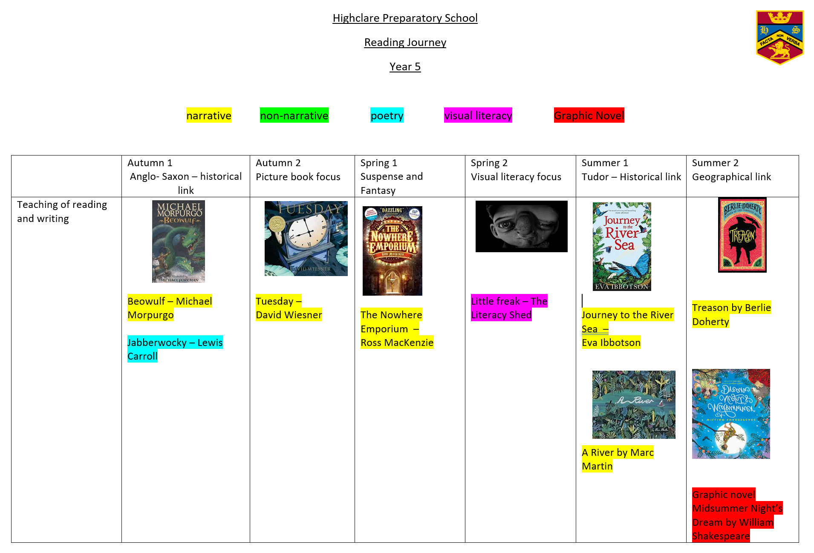
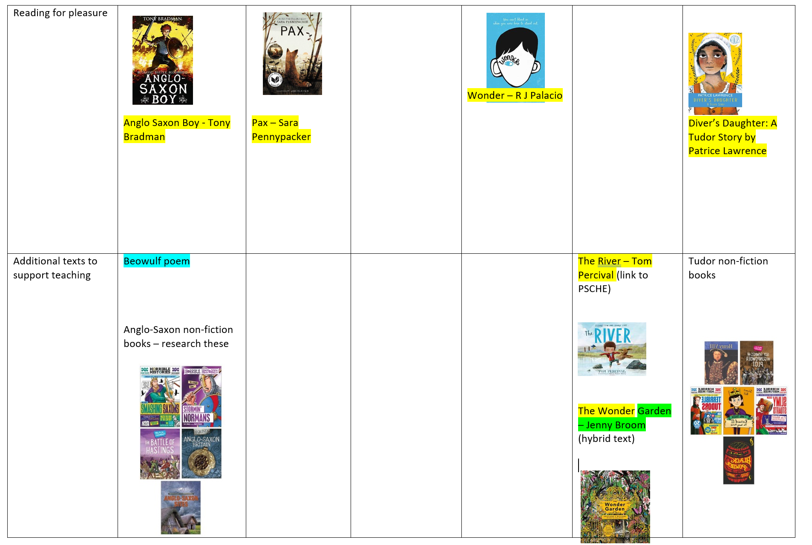
Notes:
Might see different ways of recording in books now ie more photographs, more explanations of discussions taken place in the classroom etc.

Slide 3
Promoting reading to:
support the teaching of reading and writing
develop reading for pleasure
use texts as a source of information and research
All using high-quality, carefully selected texts that offer coverage and progression.

Slide 4
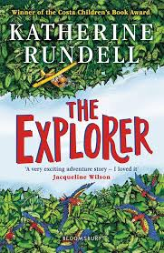
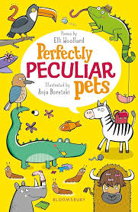
Why this? Why now?
Does the book:
-offer opportunity for pupils to encounter a different genre or format to experience a wide range of literary forms and develop their own opinion and preferences?
Notes:
Need to include a wide range of fiction, non-fiction and poetry.

Slide 5
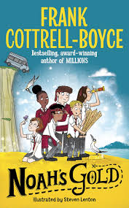
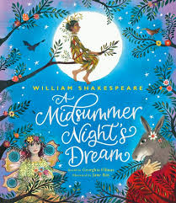
Why this? Why now?
We have planned for a range of books within each genre.
Narrative texts will feature picture books and visual literacy in each group. Graphic novels will be included in years 3-6.
Hybrid texts will be included in each year group.
Diverse and inclusive books will feature in each year group.
Poetry will offer progression throughout the school, covering a range of poetic forms with a focus on narrative poetry.
Non-fiction books are chosen not only based on their content, but also based on the layout, structure and vocabulary choices of the author.

Slide 6
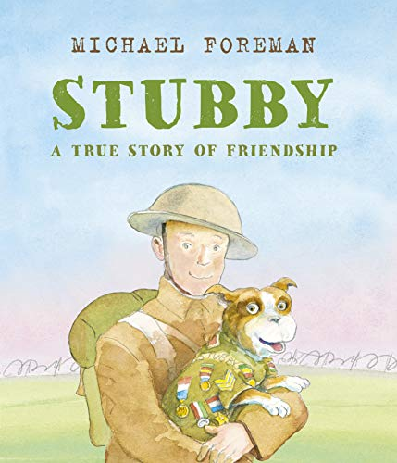
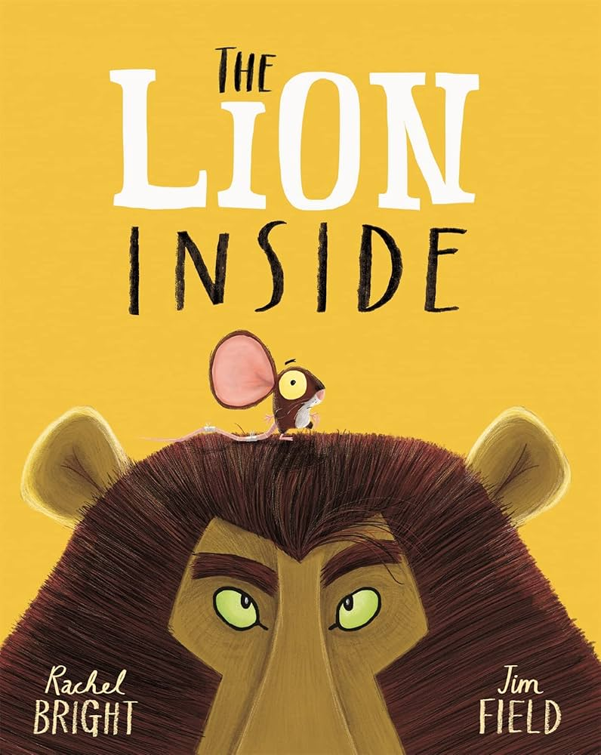
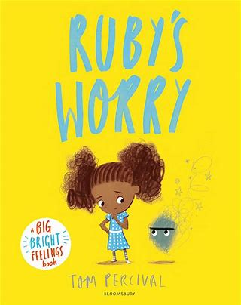
Why this? Why now?
Does the book:
-contain a ‘big’ idea at its heart, for example, the power of friendship or the power of bravery in the face of adversity?
Notes:
Why this? Why now? Every time we choose to read something to our children, recommend something ask yourself, “Why this? Why now?” What is it offering our children that they haven’t already had access to?

Slide 7
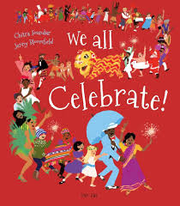
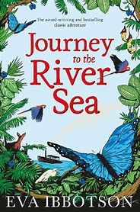
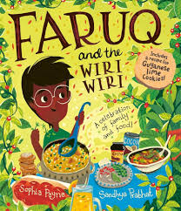
Why this? Why now?
Does the book:
-deliberately widen horizons by offering culturally rich content?

Slide 8
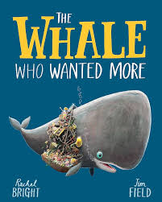
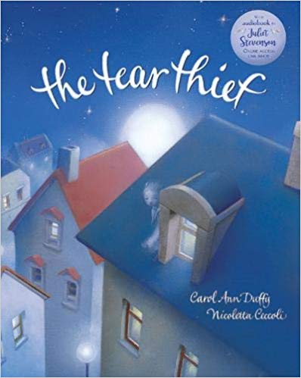
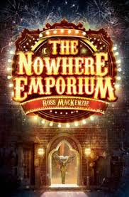
Why this? Why now?
Does the book:
-extend vocabulary?

Slide 9
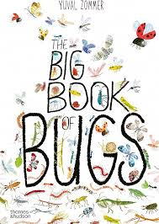
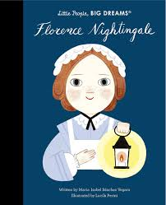
Why this? Why now?
Does the book:
-have the potential to develop pupils’ wider knowledge, broadening and deepening their understanding about another curriculum subject?

Slide 10
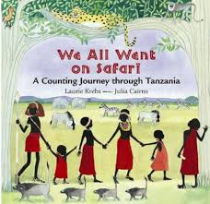
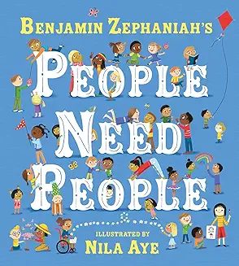
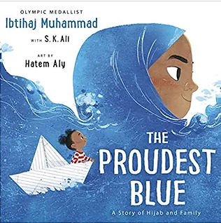
Why this? Why now?
Does the book:
-reflect a diverse range of voices and characters, reflecting the background of pupils in the school and society more widely?

Slide 11
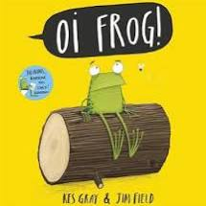
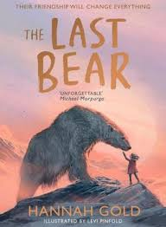
Why this? Why now?
Does the book:
-elicit a strong response – curiosity, anger, excitement, laughter, empathy?

Slide 12
Why this? Why now?
Does the book:
-engage the teacher and their class?
Notes:
Choose together.
Have an element of flexibility to allow for personal choice to be brought in by teachers.

Slide 13
Notes:
Recommend 20 minutes of reading per day.
Research suggests this can:
-Promote improved health and wellbeing
-Help build social connections and relationships
-Increased ability to succeed academically throughout all subjects
-Improve reading and writing attainment
-Improve text comprehension and grammar
-Improve vocabulary understanding and use
-Increase self-confidence as a reader
-Develop pleasure in reading in later life
-Improve general knowledge
-Develop a better understanding of other cultures
-Lead to a greater insight into human nature and decision-making
-Develop positive reading attitudes

Slide 14
Reading at home for pleasure and purpose should be made up of:
independent/silent reading
reading aloud
listening to an accomplished reader reading aloud
research/homework
Notes:
The 20 minutes should be made up of a range of…

Slide 15
Reading aloud
This can consist of listening to an accomplished reader or the child reading aloud to an accomplished reader.
One of the most important aspects of developing reading.
Why?
Fluency!

Slide 16
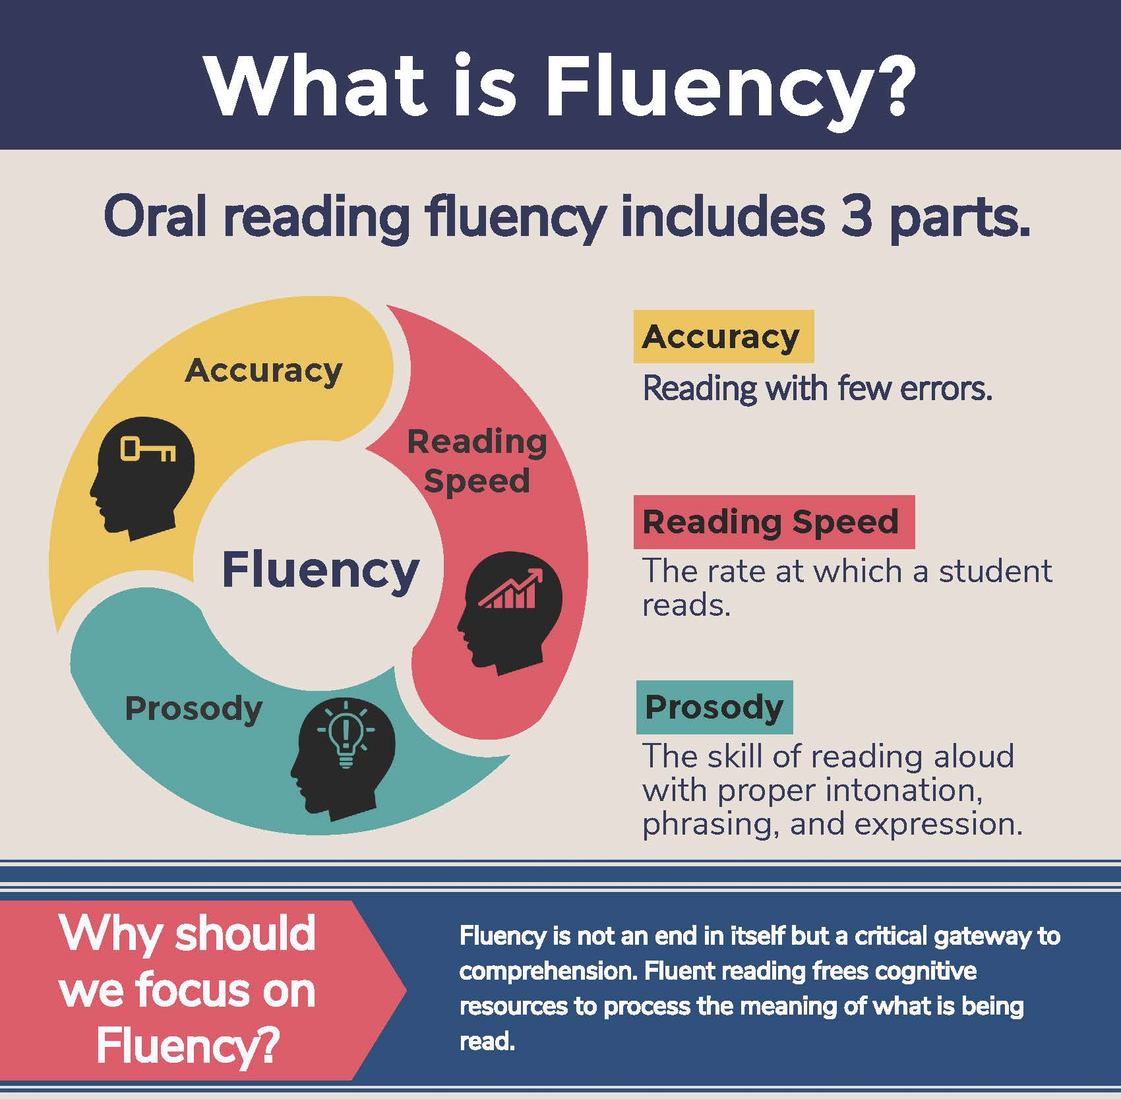
Reading aloud develops fluency
What is fluency?
Notes:
Only when all of these work together can we say the reader is fluent.

Slide 17
Reading aloud develops fluency
Why is fluency important?
Fluent reading supports reading comprehension. When pupils read fluently, their cognitive resources can be redirected from focusing on decoding and onto comprehending the text. If the brain’s processing power isn’t being used up by working out how to read a word, it can concentrate on understanding and enjoying the text.
For this reason, fluency is sometimes described as a bridge from word recognition to comprehension.

Slide 18
Reading aloud develops fluency
How can we develop fluency?
Reading and re-reading the same texts multiple times.
Echo Reading
Choral Reading
Read and follow
Discussing the punctuation marks

Slide 19
Reading aloud fosters reading for pleasure
It is opportunity to bond with our children
It sparks deep discussion
It allows children to clarify vocabulary understanding
It develops good reading habits, promoting reading as a lifelong hobby
It is an opportunity to share high-quality texts at a level beyond which they can read for themselves, allowing for vocabulary and grammar development.

Slide 20
What is comprehension?
This refers to the understanding of a text.
Mastery of comprehension skills is essential for effective reading, listening and overall communication.
Some children are able to read thanks to secure phonics knowledge and the ability to decode but do not understand what they have read.

Slide 21
Reading skills KS1
Comprehension
Vocabulary – full understanding
Retrieval – finding answers from the text
Clarifying – ask questions about the text, explain thoughts about what has been read
Inference – how do we know?
Sequencing – what were the main ideas?
Predicting – use what they know
Notes:
Always ask ‘why?’ / ‘how do you know?’

Slide 22
Reading skills KS2
Comprehension
Vocabulary – full understanding
Retrieval – finding answers from the text
Clarifying – ask questions about the text, explain what has been read/state the main events
Inference – how do we know?
Summarising – what were the main ideas?
Predicting – use what they know
Notes:
Summarising different.
Main skills are the same, but what differs is the complexity of the text.
Using multiple pieces of evidence to support inferences and explanations.

Slide 23
Visualising – Picture the text in their minds
Questioning – Make up questions about the text or picture
Monitoring – Check understanding of words, phrases, paragraphs
Text structure – Find the main features of a text type
Personal Response – What would I do?
Author’s Intent – Impact on the reader – how and why
Activate prior knowledge – Knowledge of the world
Notes:
Ask them to tell you what they think visualise something to look like. What do they see in their head?
Get them to generate questions to ask the author, character, can they ask you a retrieval question about the text instead?
Check-in to monitor their understanding – do you know what this word means? Why do you think the character acted in this way?
Text structure – identify the sub-headings, headings, paragraphs, did you know boxes and discuss why they author uses them.
Author’s intent – important because these decisions will transfer to their writing. Why has the author used that piece of language? Why have they used short, simple sentences? What effect does it have on you as the reader?
Discuss context of book – historical context, time periods, geographical knowledge needed to fully comprehend.

Slide 24
Vocabulary
Vocabulary is the key to understanding.
Interpreting words in context and deciphering the meaning of words unknown based on the context they are written.
Mr Ali loathes wearing a tie as he finds it uncomfortable.
We may not know the meaning of the word ‘loathe’ here but based on the context and other evidence within the sentence we can guess it means ‘doesn’t like’. How have I arrived at this conclusion?
Beowulf was incensed by Grendel’s attack and vowed revenge.
We may not know the meaning of the word ‘incensed’ here but we can guess it means ‘angered’. How have I arrived at this conclusion?
Notes:
Vocabulary is important in context. How can we use the knowledge in and around the sentence to hazard a guess at meaning. Can you think of another example sentence to put this word into? Can you think of a time when you have felt incensed? Tell me about it.

Slide 25
Inference
Inference is an interpretation that goes beyond the literal information given and relies on the evidence within the text as well as background knowledge.
The police find a threatening letter addressed to the victim.
We could infer that someone didn’t like that person.
The bike lay on the floor next to her as she held her leg and cried.
We could infer that the girl fell off her bike.
My stomach rumbled as the smell of dinner wafted from the kitchen.
We could infer that this person is hungry.
Notes:
When it comes to inference, ask them how they know? Why? Get them to add because to their verbal answer. It will tell you if they have understood the inference fully or not. The author gives clues to how characters are feeling without explicitly telling the reader. Can the child find them?

Slide 26
Predict
What has or what will happen based on information stated or inferred (linked closely to inference). Again, background knowledge here is important.
Beowulf snatched his sword from the armoury and ran towards the mountains.
What do predict Beowulf is going to do? What evidence have you used to make your prediction?
Miss Jackson woke up with a terrible headache and severe cough. She picked up her mobile and began to dial.
Who do you think Miss Jackson is going to call? Why?
Predictions, like inferences are neither right or wrong, they may be strong (with secure evidence to back them up) or weak (with little or poor evidence to back them up).
Notes:
Again, ask how they know? Get them to add because.
Tell them your predictions and why you think that. It will model plausible predictions for them.

Slide 27
Retrieve
Retrieval of information is often the starting point for discussing a text. This means picking the exact information out of the text that they have just read. E.g.
What was the character’s name?
What did they eat for dinner?
What colour was the car?
What time did…
As children begin to read longer texts, skills such as skimming and scanning will also be taught to aid retrieval.

Slide 28
Sequence (to Y2)
The awareness of chronology. The ability to identify the main events within a text and order them correctly.
Summarise (Y3-6)
Summarise main ideas from a paragraph, a selection of text or the text as whole.
What is the main point of the first paragraph?
What heading would be appropriate for this paragraph?
Summarise the first page in five sentences.
Notes:
Up to Y2, get them to retell the story in order. Draw a picture of the beginning, middle, end. Muddle the pictures up – can they order them correctly?
Summarise is a difficult skill – not too much information and not too little. We want a summary not a retell of the whole text. Give them criteria – summarise in 5 sentences, 20 words, choose the 5 most important facts.

Slide 29
Clarify/Explain –
This shows good understanding of a text. When children clarify, they check to make sure that they understand what they have read and then they go back to clear up anything confusing. They might use a dictionary for this, re-read a section, reflect on the text so far, utilise prior knowledge, look at the illustrations or ask questions to further their understanding.
Notes:
This is a skill that needs developing over time and needs constant modelling. If you come across a word they don’t understand, steer them to a dictionary to find a definition. Model how re-read a section to clarify your own understanding and explain why you are doing that.

Slide 30
Sometimes, we may ask children at home questions to check their comprehension.
Sometimes, we will just read to them for pleasure.

Slide 31
Here are some questions to help to start and sustain a book discussion with your child:
Before your child reads a book, ask:
Why did you select this book?
What makes you think this book is going to be interesting?
What do you think the book is going to be about?
Does this book remind you of anything else you’ve already read or seen?
What kind of characters do you think will be in the book?
What do you think is going to happen?

Slide 32
Here are some questions to help to start and sustain a book discussion with your child:
While your child is reading a book, try asking:
Will you catch me up on the story? What’s happened so far?
What do you think will happen next?
If you were that character, what would you have done differently in that situation?
Where is the book set?
If the main character in that story lived next door, would you be friends?
What does the place look like in your head as you read? Would you want to visit there?
Did you learn any new words or facts so far?

Slide 33
Here are some questions to help to start and sustain a book discussion with your child:
After your child has finished a book, ask questions like:
What was your favourite part of the book? Why?
Who was your favourite character? Why?
What was the most interesting thing you learned from the book?
Why do you think the author wrote this book?
Would you have ended the book differently? Did it end the way you thought it would?
Did the problem of the book’s plot get solved?
If you could change one thing in the book, what would it be?
Would you recommend this book to a friend? Why or why not?
If so, who would you recommend it to?
Notes:
Important to explore the book after reading, too. It’s nice to evaluate if they enjoyed it as a reader as this will grow and develop reading habits i.e. would they choose a book by that author again? Why or why not? Critically evaluate it which will impact their own writing habits i.e. did you like the way the author presented the information? If you were the author, would you do anything differently? Why or why not?

Slide 34
A rich reading diet consists of:
Narrative
Non-narrative
Poems
Nursery rhymes
Newspapers
Magazines
Graphic novels
Recipes
Leaflets
Online reviews
Ebook…

Slide 35
Useful websites
Young Readers Programme: booklists | National Literacy Trust
thereaderteacher.com
booksfortopics.com
lovemybooks.co.uk
schoolreadinglist.co.uk
lovereading4kids.co.uk

