Slide 1
Highclare Preparatory Schools
Cygnets and Swans
Pastoral Evening

Slide 2
Aim: To help you understand how we support emotional resilience and how this can be used out of the school setting.
Emotional Environment
Mindfulness
Positive Behaviour

Slide 3
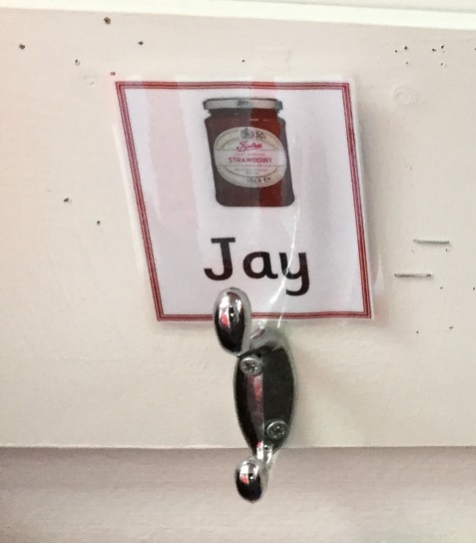
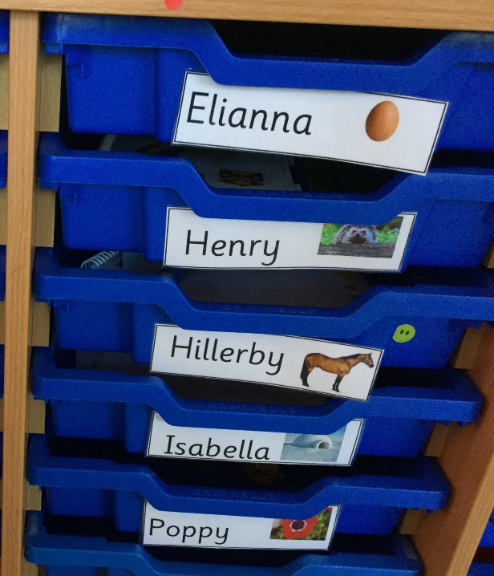
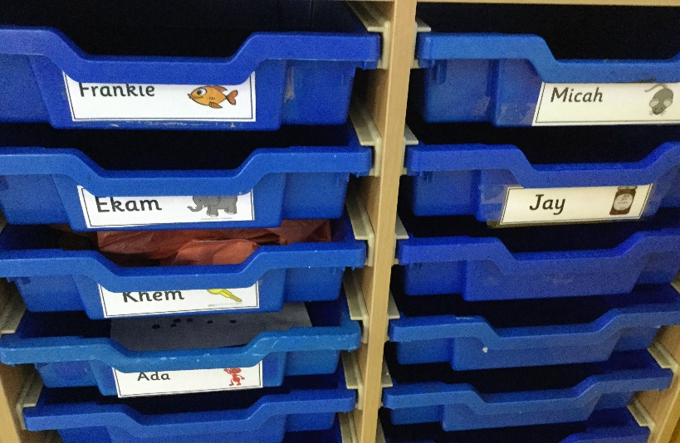
Emotional Environment
Notes:
Go through the timetable (parents to refer to the curriculum information letter for specific curriculum content)

Slide 4
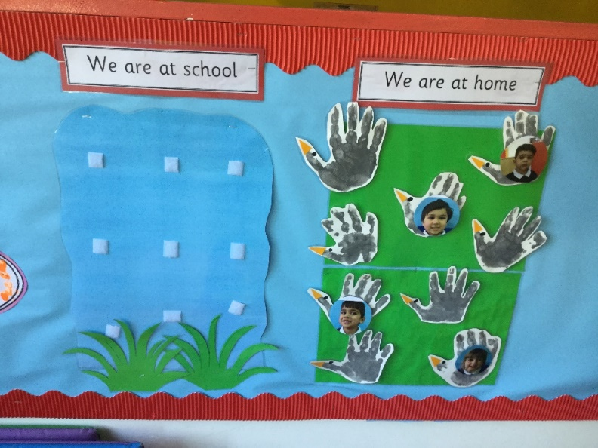
Self-Registration in Cygnets

Slide 5
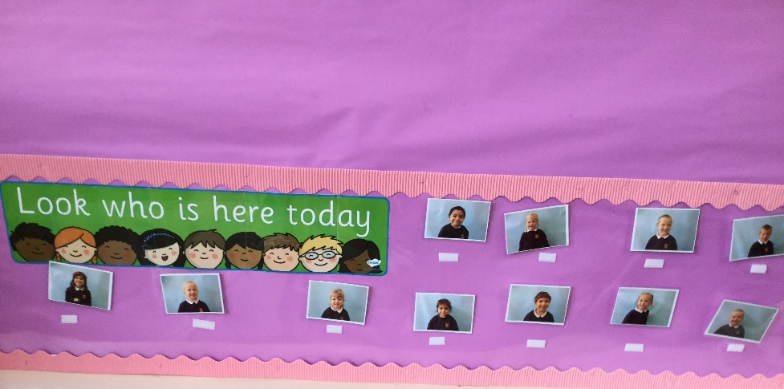
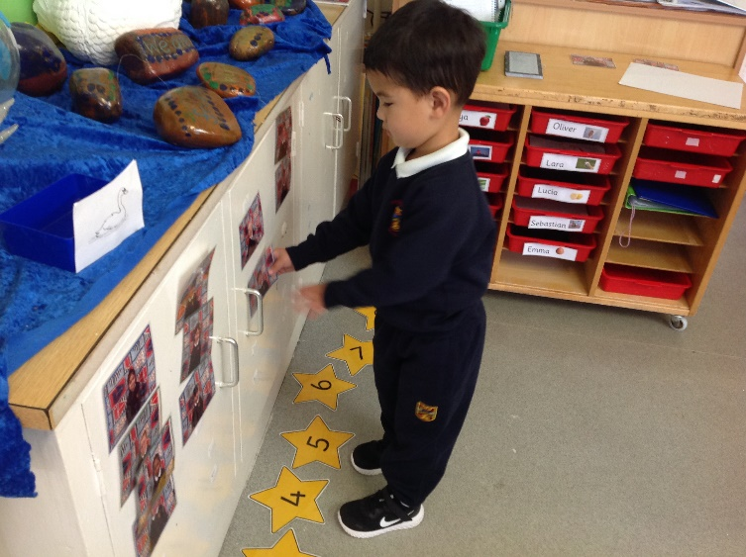
Self-Registration in Swans

Slide 6
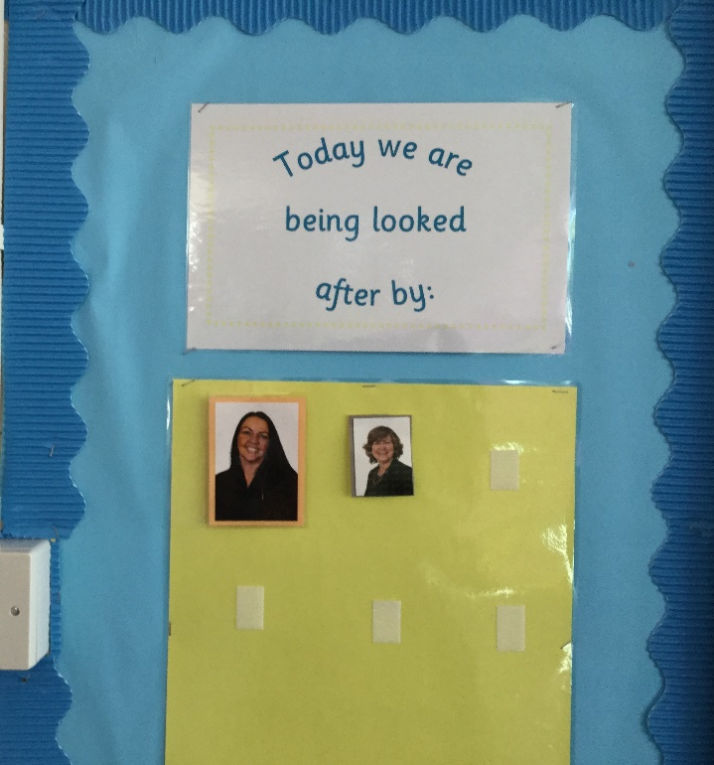
Who is looking after us today?
Notes:
Homework should only take the prescribed amount of time (if it’s not finished parents can make a note in the homework diary)
Discuss Talk Homework, spellings and times tables/Keeping Skills Sharp (J5) etc.
Extra homework will always be provided at a parent’s request

Slide 7
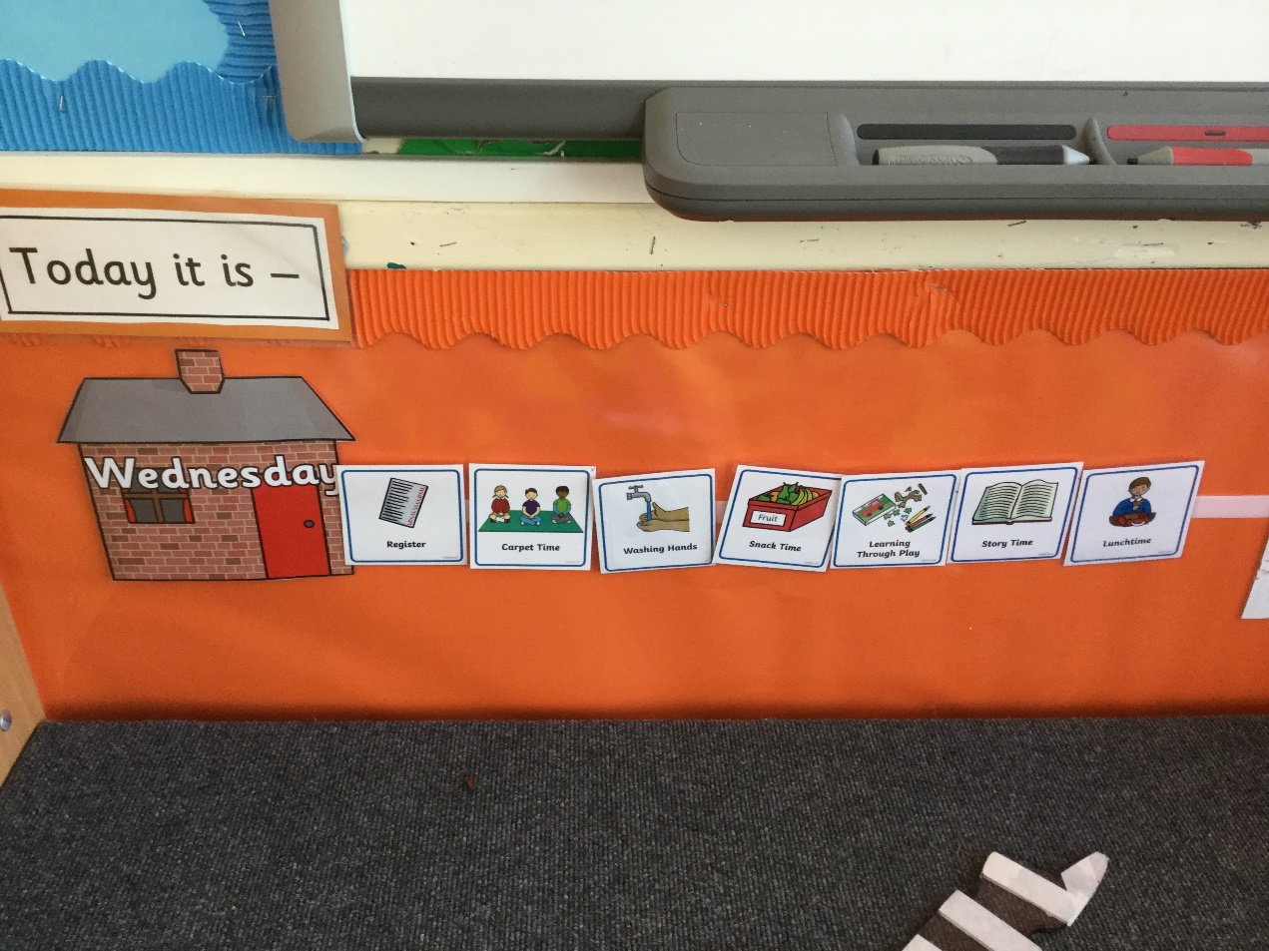
Visual Timetable

Slide 8
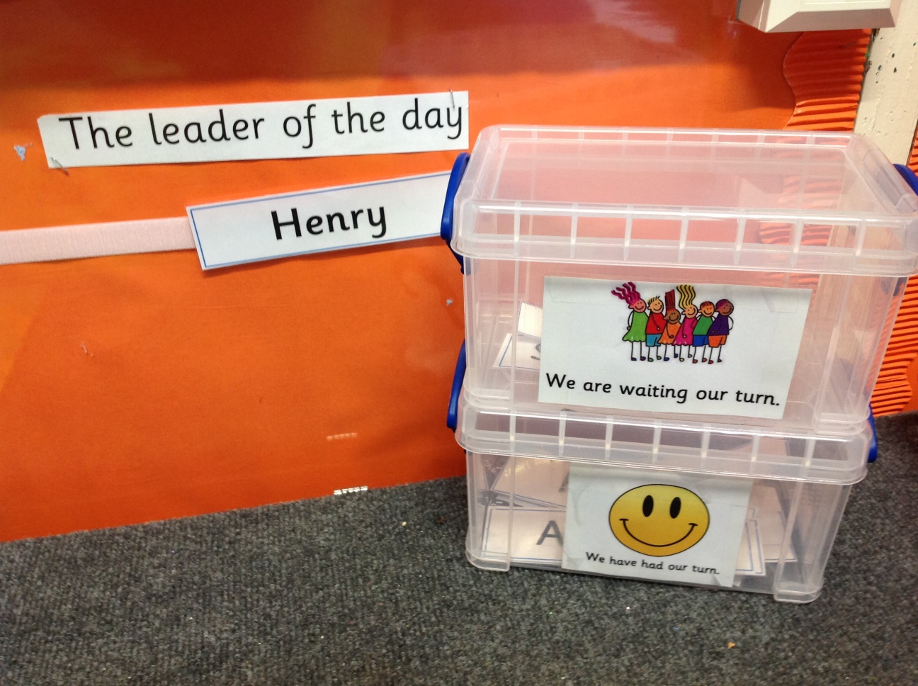
Leader of the day
Notes:
Explain how children can use Highclare Virtual – lessons
Explain how parents can use Highclare Virtual to see the children’s homework and letters sent home (they use their parent log on)

Slide 9
Snack Mats

Slide 10
Lunch Mats

Slide 11
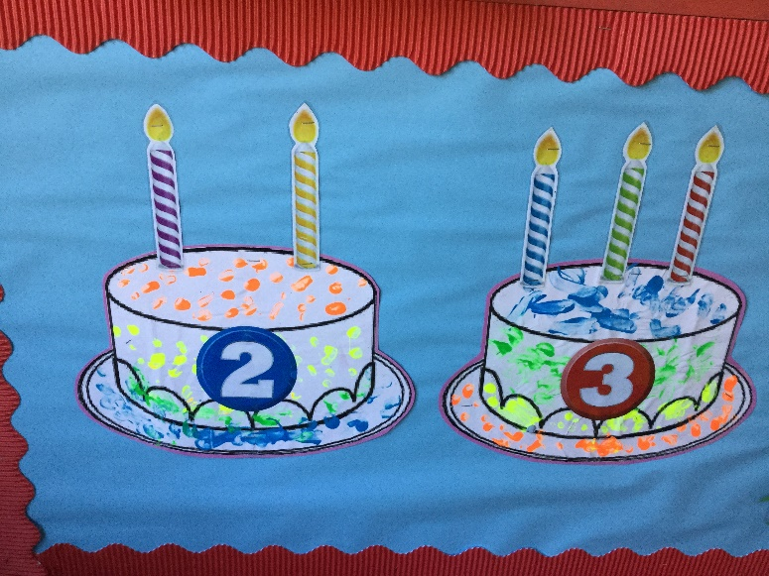
Birthdays in Cygnets
Notes:
NB we have a number of children in school with severe nut allergies

Slide 12
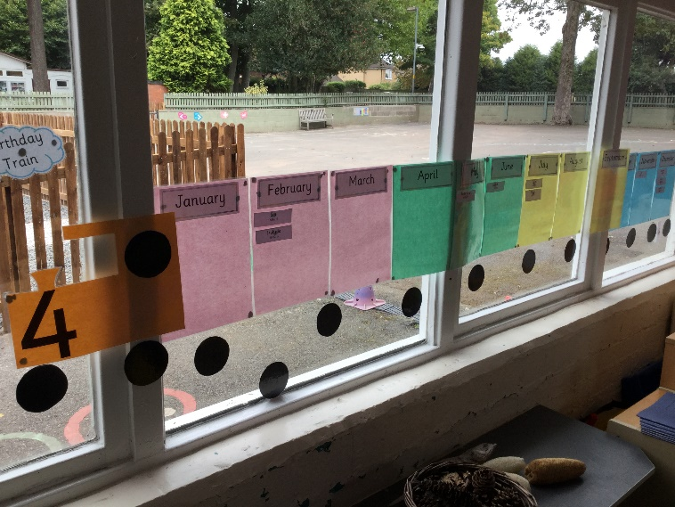
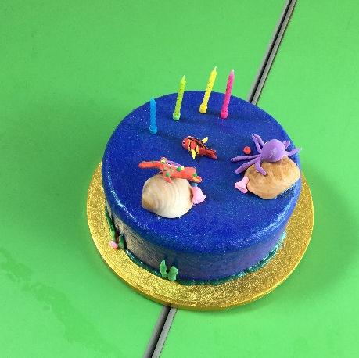
Birthdays in Swans

Slide 13
Mindfulness
Mindfulness is a way of bringing attention to the present moment, including mindful eating.
Helping children to learn techniques to calm themselves, breathing techniques.
Cosmic Kids Yoga
Calming music
Outdoors sensory exploration
Notes:
Please remind parents to book their children into TOPs (due to staff ratios)

Slide 14
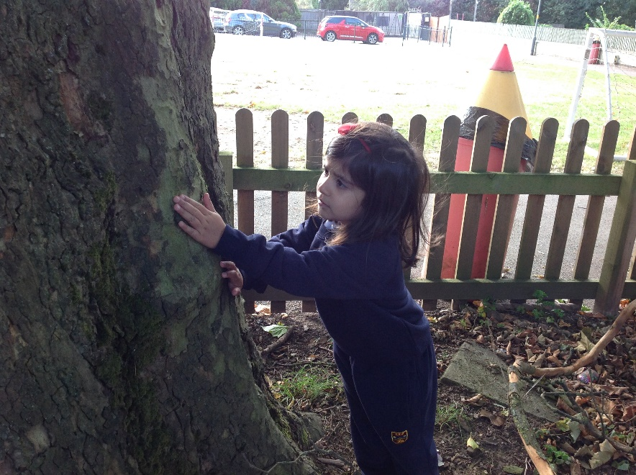
Being close to nature

Slide 15
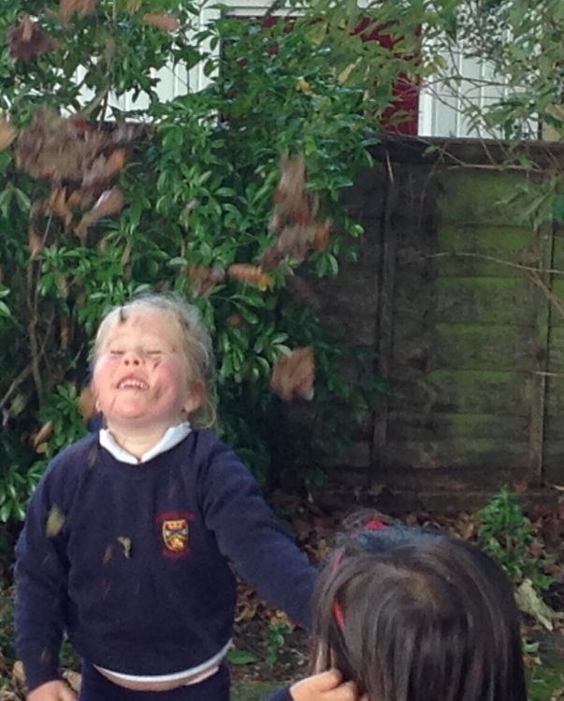
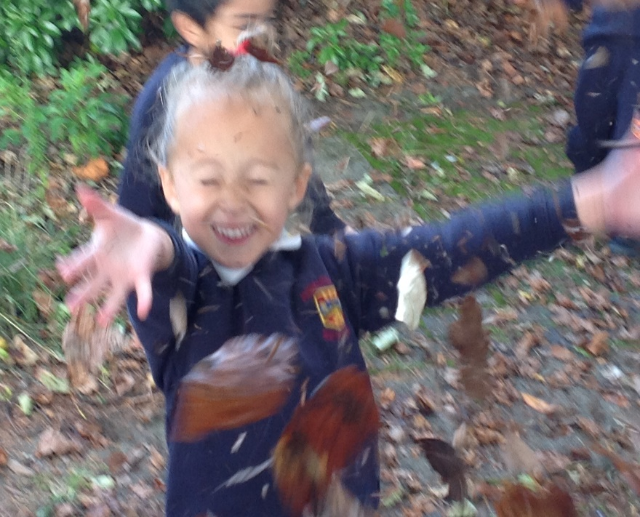

Slide 16
Learning to focus on breathing

Slide 17
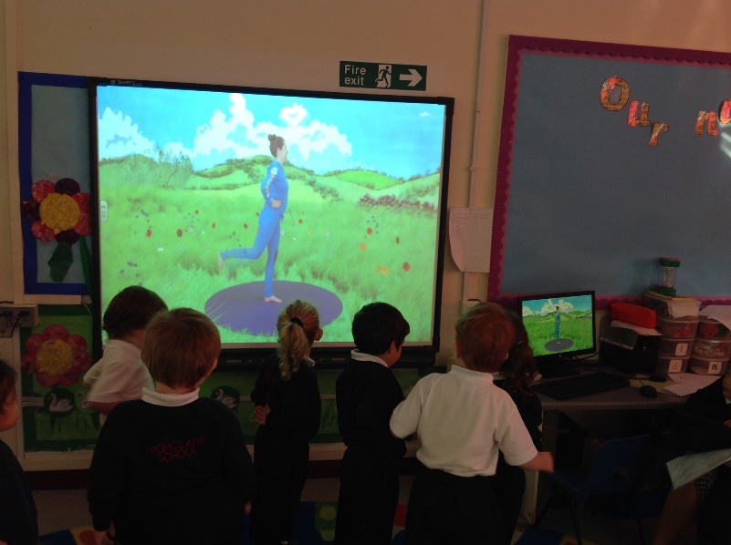
Cosmic Kids Yoga

Slide 18
Positive Behaviour
“When our emotions
overwhelm concentration
our working mind is swamped,
we can’t think straight.”
Daniel Goleman

Slide 19
Development Matters
Positive Behaviour
Birth to 3 years old: Find ways to calm themselves, through being calmed and comforted by their Key Person
Feel strong enough (emotionally safe enough) to express a range of emotions
Begin to show effortful control
3 and 4 year olds: Talk about their feeling using words like happy, sad, angry or worried.
Begin to understand how others might be feeling.
Note – Be wary of expecting children to say “sorry” before they have a real understanding of what this means. Try to develop empathy eg “How would you feel if…”

Slide 20
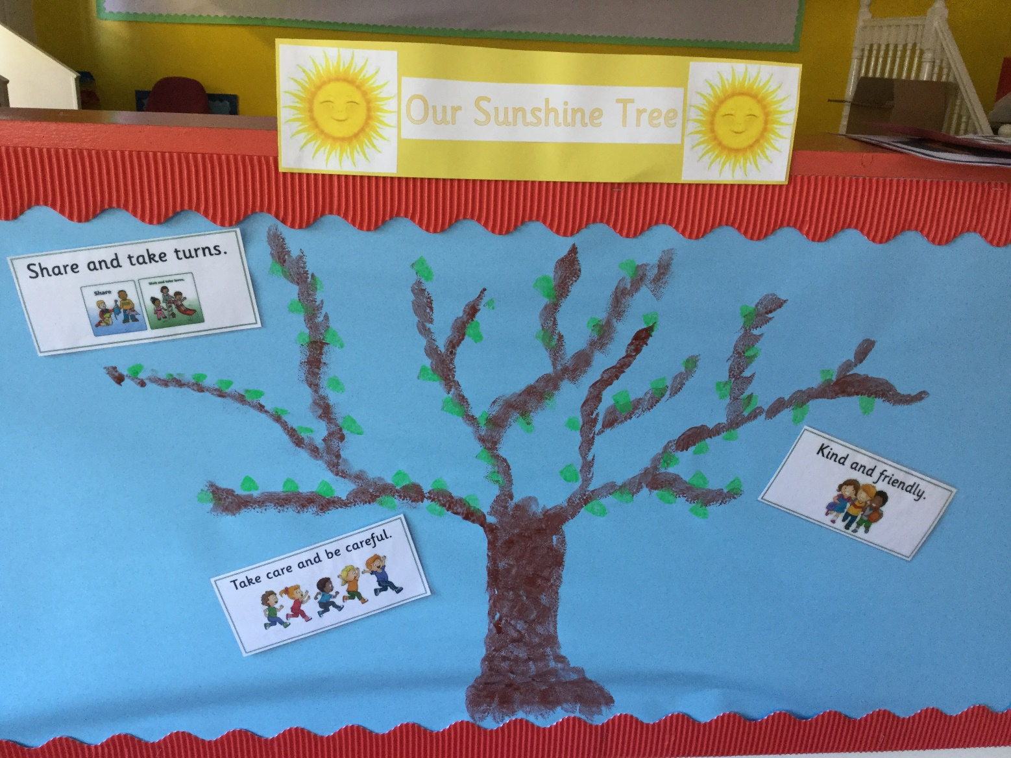
Positive Behaviour in Cygnets

Slide 21
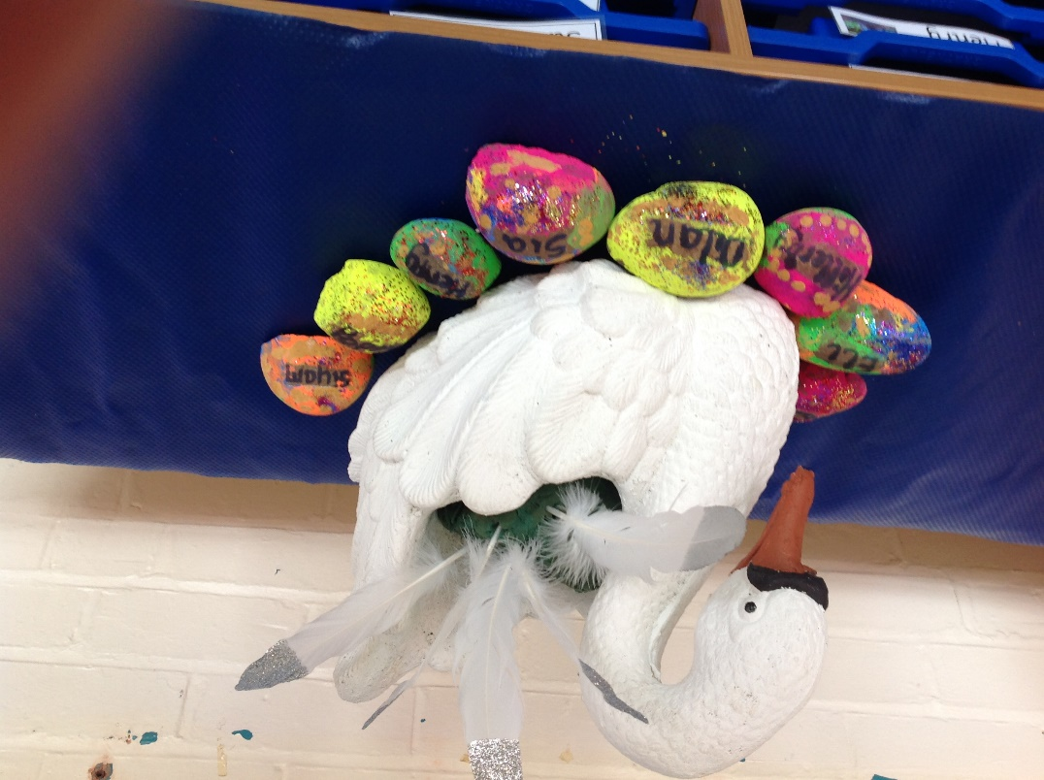
Positive Behaviour in Swans

Slide 22
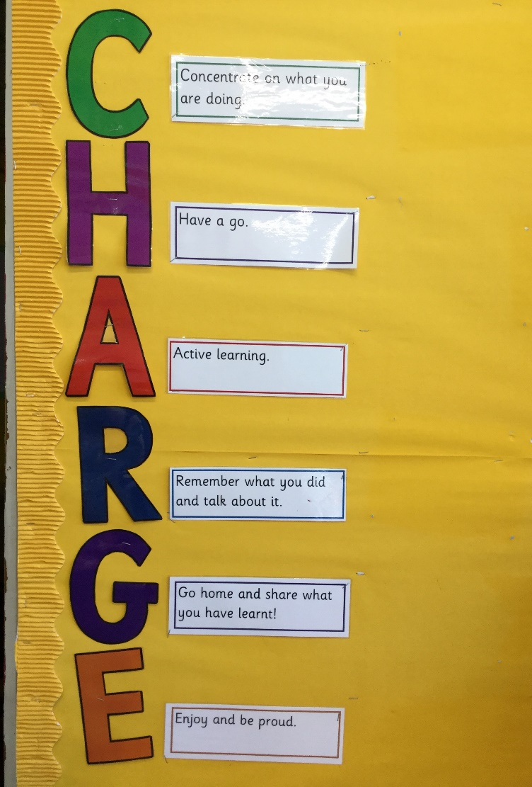
Take Charge

Slide 23
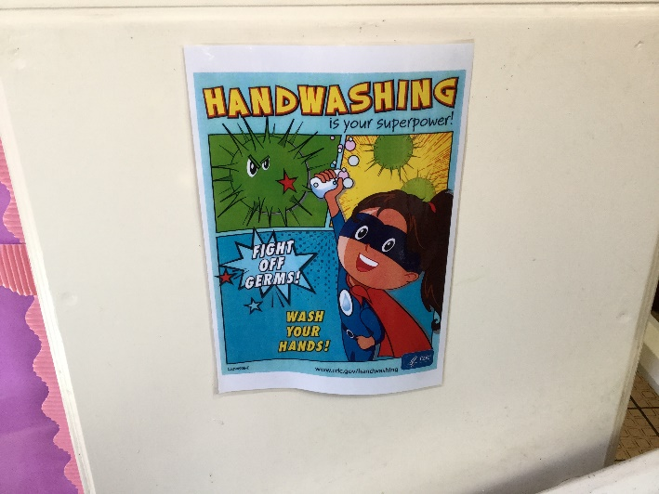
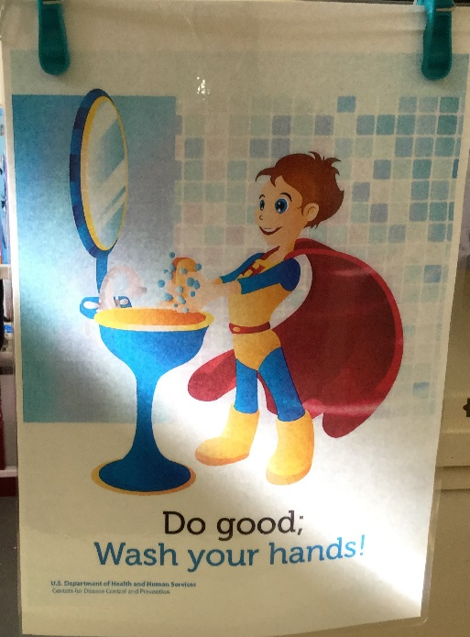
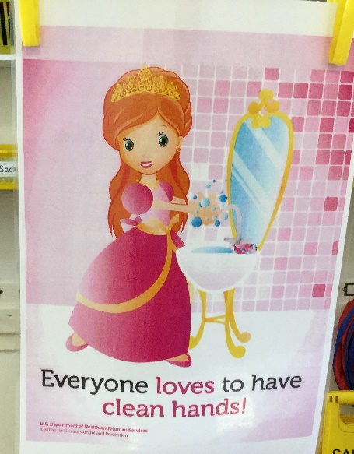
COVID 19

Slide 24
A People Place
If this is not the place where tears are understood,
Where do I go to cry?
If this is not the place where my spirits can take wing,
Where do I go to fly?
If this is not a place where my questions can be asked,
Where do I go to seek?
If this is not a place where my feelings can be heard?
Where do I go to speak?
If this is not the place where you’ll accept me as I am,
Where can I go to be?
If this is not the place where I can try and learn to grow,
Where can I just be me?
William J Crocker

