Slide 1
Elevate Education
Study Sensei

Slide 2
SEMINAR OVERVIEW
Create
Master
Learn

Slide 3
LEARN

Slide 4
RULE 1: USE YOUR SPECIFICATION/SYLLABUS
Find the assessment objectives
Make notes on the bullet points
Cross-check before exams
Examination Board website

Slide 5
EDEXCEL BIOLOGY SPECIFICATION
✔
✔
✔
✔
Courtesy of Edexcel

Slide 6
RULE 2: TAKE NOTES DURING THE TERM
Use the syllabus to make notes
Use a note making planner
Finish Notes
Memorise Notes
Practice Questions
Exam

Slide 7
RULE 3: ORGANISE NOTES
Re-writing notes is a waste of time
Ordered notes improves memory

Slide 8
RULE 4: Pay Attention to Space and Colour
Heading
Sub-heading
TRIGGER WORDS
TW
TW
Sub-heading
TW
TW
TW
Sub-heading
TW
TW
Use trigger words
Most people need to reduce the number of words they use by up to 80%
2. Colour-code notes to increase memory.

Slide 10
Master
10

Slide 11
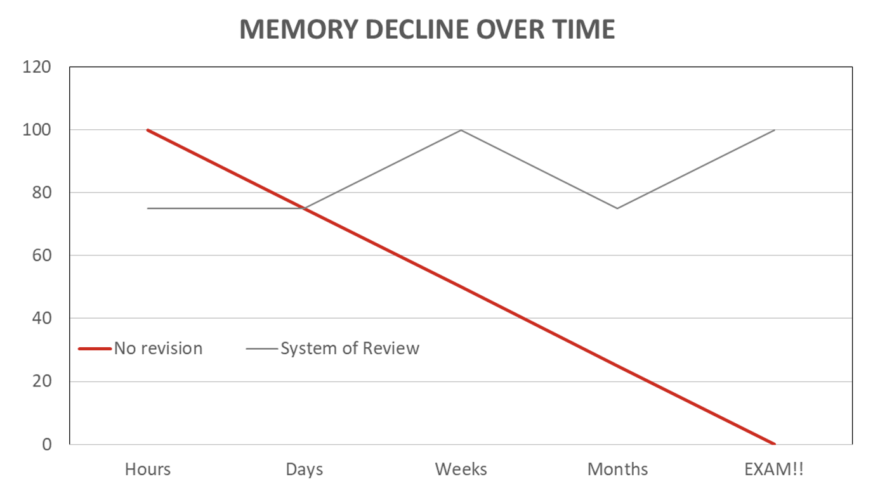
RULE 1: USE A SYSTEM OF REVIEW
Take notes
Review immediately
Review 24 hours later
Review monthly

Slide 12
RULE 2: USE VISUAL TOOLS
Images and diagrams are easier to remember
Mind maps become notes and plans in the exam room

Slide 13
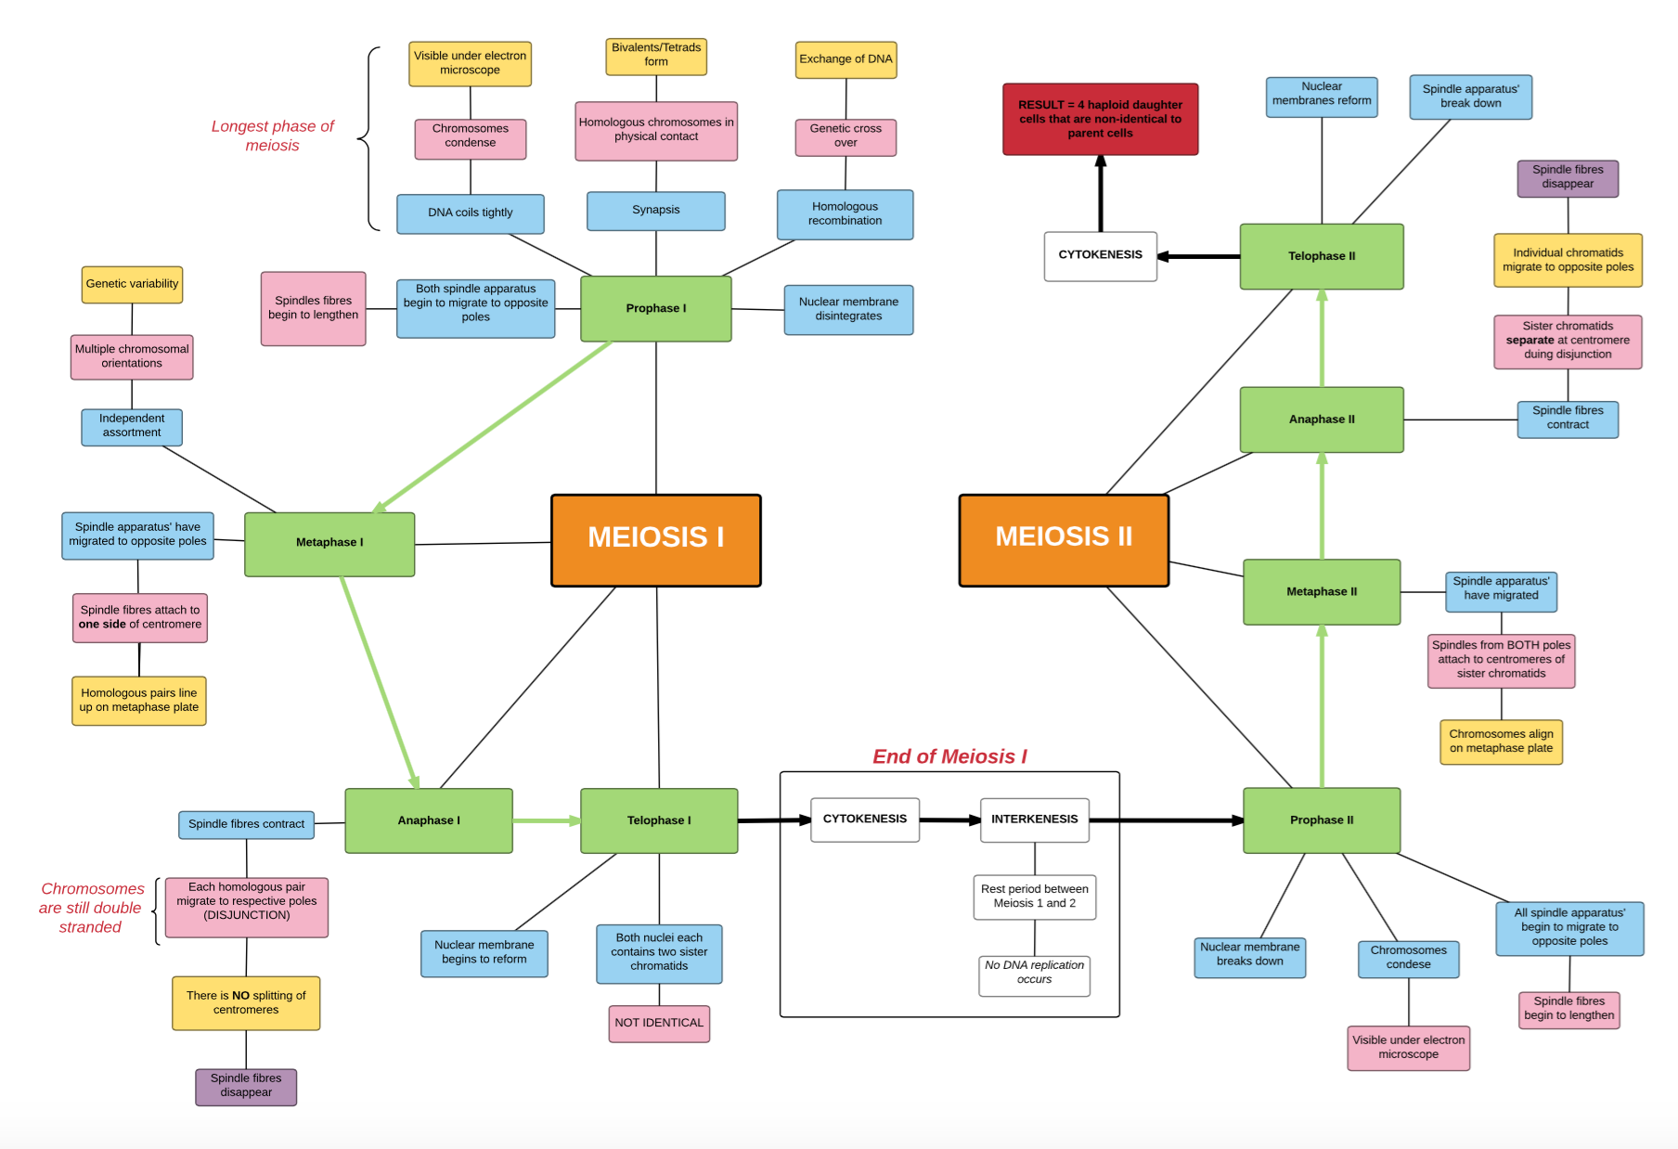

Slide 14
RULE 3: DO PRACTICE PAPERS
Do 3/5 practice papers per subject
Do them open book and open time
Do final papers under exam conditions
Get them marked

Slide 15
Create
15

Slide 16
RULE 1: INDEPENDENT WORK
Creating is crucial in order to…
Rule 1: Extra Reading
1. Cover core content as you go
2. Check your syllabus
3. Check past papers
4. Look for:
Quotes and evidence
More in depth ideas
New information or alternative arguments
5. Put these in a different colour in your notes!
STAND OUT

Slide 17
rondo

