Slide 1
Preparing for Examinations Revision guide for KS3 students and parents

Slide 2
Like it or not…
Revision matters
Exams matter
Results matter
You may even come to love tests!!!
Test are actually great way of finding out exactly what we know and don’t know, so we can go back and learn topics we are missing
GCSE may seem a long way off but it’s during KS3 that you can start to develop the revision skills you need for success in these exams.
GCSEs are mainly assessed by an exam so the more practice the better!!

Slide 3
The Basics
Throughout the year it is important to do the following. This will only help when it gets closer to examination time…
Be on time for school, all lessons and activities.
Be organised with books and homework.
Listen in class and complete all your class and homework to the best of your ability.
Ask for help if you are not sure about any of your work.
As far as possible copy up any notes and attempt tasks when you have been absent – it’s bound to be in the exams!

Slide 4
General tips for any examination period
Start revision early – last minute cramming never works!
All revision done throughout the year in KS3, whether it is for the end-of-year examinations or smaller class assessments, only makes life a bit easier when you get to GCSE
Create a revision timetable
On top of homework, students should spend a bit of time doing general revision. Create a timetable to balance your time.
Revise with others as well as independently
You may benefit from teaching others what you know or testing them on what they know. Having a small study group can also be a great way to come up with unique methods for remembering key ideas

Slide 5
General tips for examination success
Take regular breaks
Revision is only effective when split up by breaks. Don’t overwork yourself and make sure you’re giving your brain some space to breathe. You’ll get distracted less and be able to focus for longer. Use these breaks to fit in any exercise or healthy eating, which will only improve the quality of your revision.
Move around
A productive way to spend your study break. The benefits of exercise on revision include increased focus, improved memory and the chance to readdress any hard topics with a fresh mind. A simple walk around the block can be all it takes to improve your quality of learning.

Slide 6
General tips for examination success
Eat Healthily
Choose healthy foods to eat during your study breaks. The quality of what you put in will dictate the quality you put out. Swapping crisps or chocolate for nuts or fruit will leave you feeling less lethargic in the afternoon and with more energy to learn. But do remember balance. You don’t have to cut out your favourite treats completely. Moderation is key.
Sleep
These revision tips won’t be effective unless you get sufficient sleep. Prioritise getting 7–9 hours a night. Sleep is a powerful tool for not only committing what you’ve learnt during the day to long-term memory, but it also improves your ability to learn again the following day.
You’ll be better able to concentrate, and feel more motivated, after a good night’s rest.

Slide 7
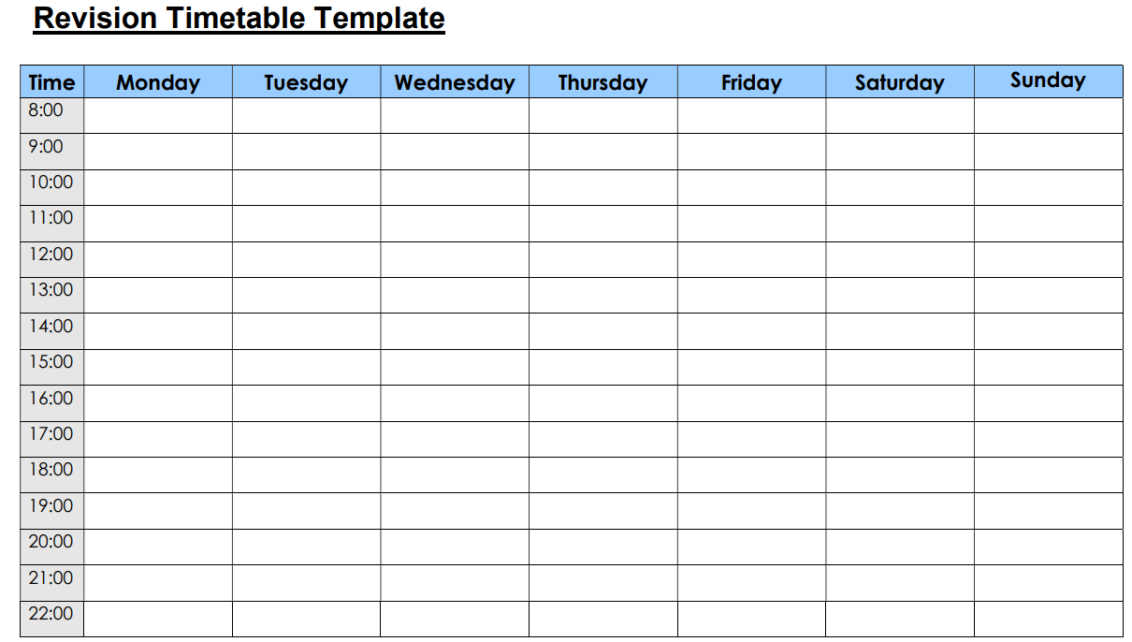
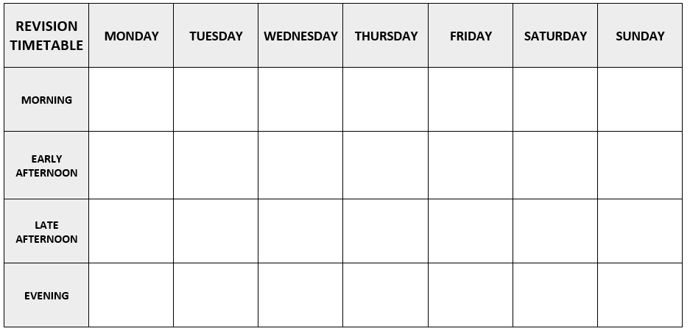
Activity: Make a start on a revision timetable.
Pick the template you would prefer, and start filling it in..
Remember
Make the slots for each subject about 30 minutes
Make good use of mornings on the weekend – this is when we concentrate best
Include breaks and time for your hobbies/other interests
Think about a sensible bedtime!
Don’t panic if you fail to stick to the plan on the occasional day

Slide 8
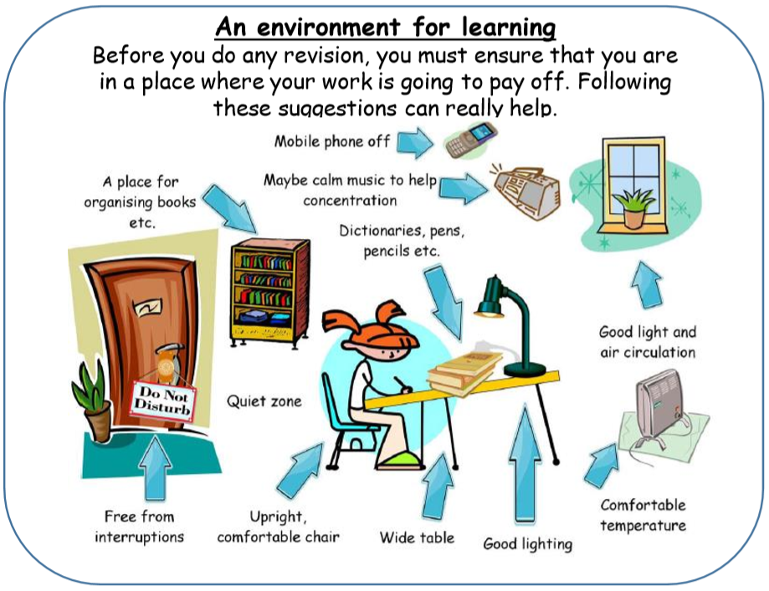

Slide 9
Activity – where will I revise?
Discuss in pairs where you do your schoolwork at home, and what you will and won’t need with you when you are working!
Share any good ideas you have!

Slide 10
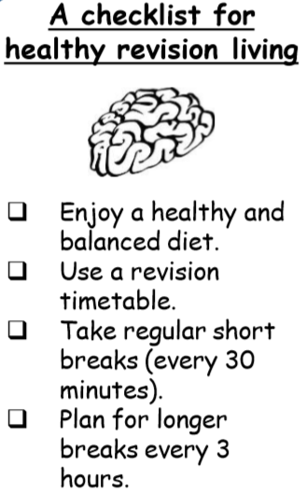
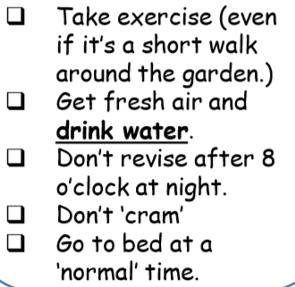
Activity
How many of these do you think you are able tick off?

Slide 11
Which Revision Strategies Should I Try?
Over the next few slides we will look at some different techniques and strategies to help you remember your subject content.
They won’t all work for everyone, so you need to try them out and see which ones work best for you.
In general, evidence tells us that more active revision- writing notes, mind maps, and practicing answers to questions for example- is more effective, and helps us remember and learn things far better than simply reading through books or watching videos.

Slide 12
1 – Making Notes (Post-its, Flash cards)
The general idea here is to reduce the amount of information you have to look through
Condense everything from your textbooks and exercise books into the main ideas and facts
Notes:
SMS to present

Slide 13
1 – (continued) Post-it Notes
Notes:
SMS to present

Slide 14
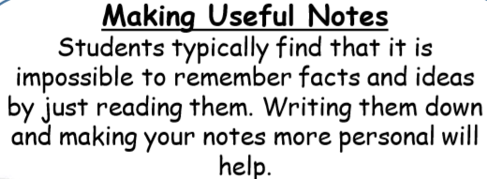
1 – (continued) Index/Flash Cards
Notes:
SMS to present

Slide 15
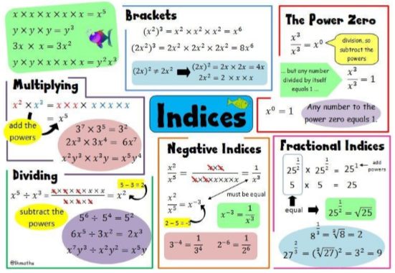
1 – (continued) Index/Flash Cards
Try using colour and highlighting, even small pictures to make your cards or post-its more interesting. Collate them into a poster on a given subject or topic
Read them, cover them over and see if you can remember the information. Do it several times, spread out over a period of time to help it remain in your memory.
Notes:
SMS to present

Slide 16
Activity: Index/Flash Cards
- Take a plain piece of A4.
- Split the page up into smaller squares/rectangles
Pick a subject and write down as many facts, which you think you will need to remember for the exam, as you can.
You can do this in pairs or as a whole class
Notes:
SMS to present

Slide 17
2 – Mind Maps
Mind maps can be a great way to display, and help you learn, lots of connected information. The allow for a lot of freedom in how you show things.
There are a few different types and ideas to help you…
Notes:
SMS to present

Slide 18
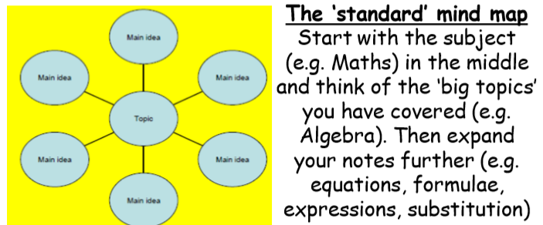
2 – Mind Maps (continued)
Notes:
SMS to present

Slide 19
2 – Mind Maps (continued)
Notes:
SMS to present

Slide 20
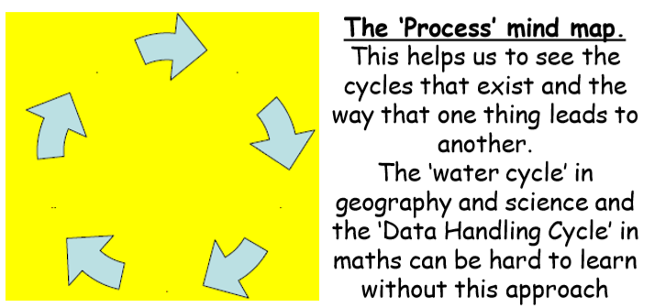
2 – Mind Maps (continued)
Notes:
SMS to present

Slide 21
2 – Mind Maps (continued)
You want to make your mind map as stimulating for you brain as possible. This will you remember the contents!
Use wavy lines and arrows rather that straight ones
Use colour, and even pictures if you can. At least have once central image to help you.
Notes:
SMS to present

Slide 22
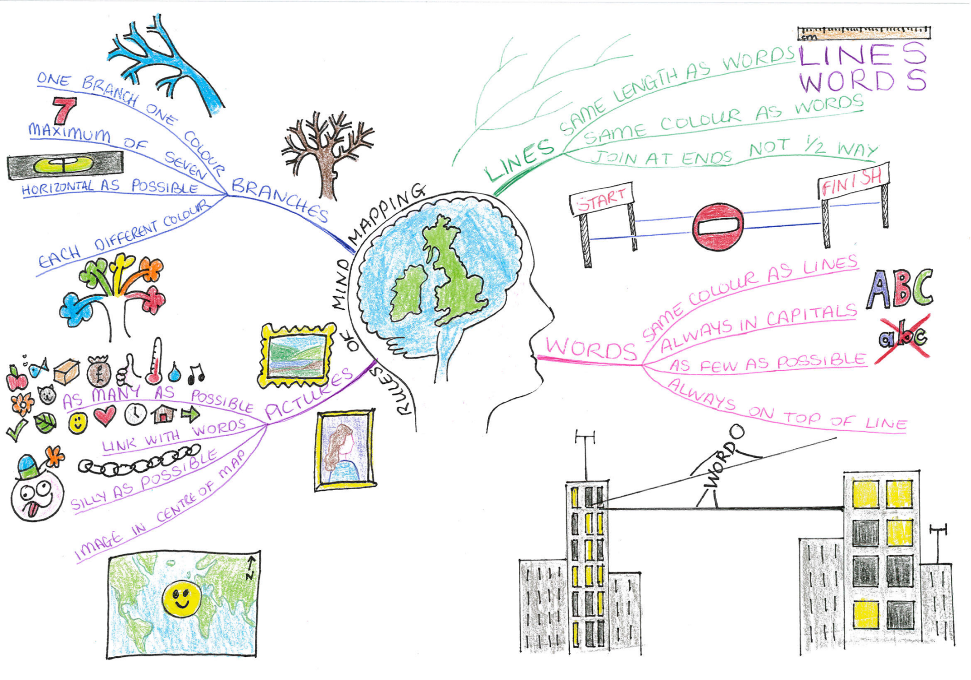
2 – Mind Maps (continued)
Notes:
SMS to present

Slide 23
Activity – Mind Maps
Work in pairs or as a class to build an example mind map for one your subjects.
Make it as interesting/colourful to look at as you can to help it be memorable
Notes:
SMS to present

Slide 24
3 – Study Buddy / Study Group
Whilst you can do great revision on your own, sometimes working together with friends can also really help!
Why not arrange to revise with someone or a small group in the learning centre once a week?
Notes:
SMS to present

Slide 25
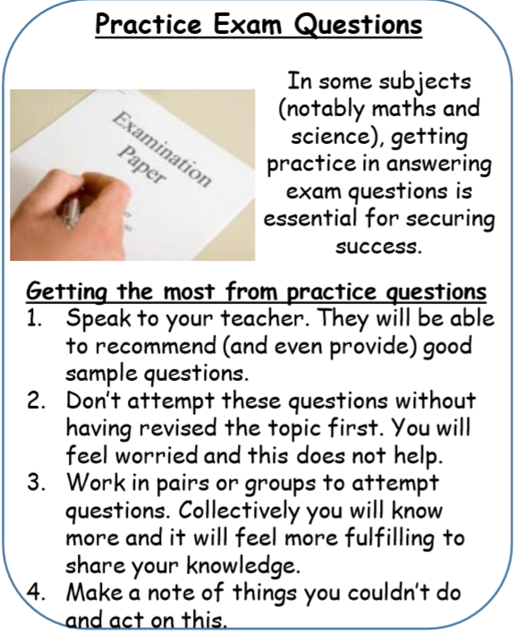
4 – Practising Exam-style questions
Teachers will also be able to recommend great website where you can practice questions interactively,
eg Kahoot
Activity
What other websites can you think of that you can use to revise? Think across as many subjects as you can.
Notes:
SMS to present

Slide 26
5 – Mnemonics
Notes:
SMS to present

Slide 27
6 – More creative ideas!
Notes:
SMS to present

Slide 28
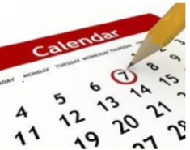
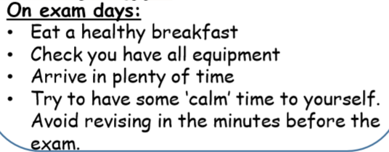
7 – Work to a deadline!
Get organised!
KS3 examinations this year are in the week starting
Monday 23rd May
Notes:
SMS to present

Slide 29
Final tips
Don’t imagine that life will go on as ‘normal’ during important examinations. It won’t. This is an important time in your school year.
You must be prepared to make some sacrifices to make sure that you do the very best that you can. However, also plan a timetable that allows you have time off. Starting early is the key here.
Don’t be negative about what you think you can achieve. Revising thoroughly and receiving the help and support of the people around you will make all the difference. So, don’t tell yourself you “can’t do it anyway” – that’s just opting out.
Don’t think it will be enough simply to read through your notes. It won’t. Very few of us have a photographic memory. You will need to employ other techniques.
Use all the ideas in this guide to find out what works well for you. Enjoy using a variety of ways of revising to keep it more fun!
Fail to prepare then prepare to fail!
Notes:
SMS to present

Slide 30
REMEMBER!
Be positive
You can do it
Try to achieve your targets
Take charge and be successful
Fail to prepare then prepare to fail!
Notes:
SMS to present

