Slide 1
GCSE Revision techniques

Slide 2
General tips for GCSE success
Start revision early – last minute cramming never works!
All revision done in the L5 year, whether it is for the end-of-year examinations or smaller class assessments, only makes life a bit easier in U5.
Create a revision timetable
On top of homework, students should spend a bit of time doing general revision. Create a timetable to balance your time.
Revise with others as well as independently
You may benefit from teaching others what you know or testing them on what they know. Having a small study group can also be a great way to come up with unique methods for remembering key ideas

Slide 3
General tips for GCSE success
Take regular breaks
Revision is only effective when split up by breaks. Don’t overwork yourself and make sure you’re giving your brain some space to breathe. You’ll get distracted less and be able to focus for longer. Use these breaks to fit in any exercise or healthy eating, which will only improve the quality of your revision.
Move around
A productive way to spend your study break. The benefits of exercise on revision include increased focus, improved memory and the chance to readdress any hard topics with a fresh mind. A simple walk around the block can be all it takes to improve your quality of learning.
Use practice papers (more appropriate for U5)
Perhaps more appropriate for revision in U5 when you have completed more of the course

Slide 4
General tips for GCSE success
Eat Healthily
Choose healthy foods to eat during your study breaks. The quality of what you put in will dictate the quality you put out. Swapping crisps or chocolate for nuts or fruit will leave you feeling less lethargic in the afternoon and with more energy to learn. But do remember balance. You don’t have to cut out your favourite treats completely. Moderation is key.
Sleep
These GCSE revision tips won’t be effective unless you get sufficient sleep. Prioritise getting 7–9 hours a night. Sleep is a powerful tool for not only committing what you’ve learnt during the day to long-term memory, but it also improves your cognitive ability to learn again the following day. You’ll be better able to concentrate, and feel more motivated, after a good night’s rest.
Use practice papers (more appropriate for U5)
Perhaps more appropriate for revision in U5 when you have completed more of the course

Slide 5
Specific tips for Revision
The next few slides contain some evidence-based ideas to help you remember your subject content.

Slide 6
Which Revision Strategies Should I Try?

Slide 7
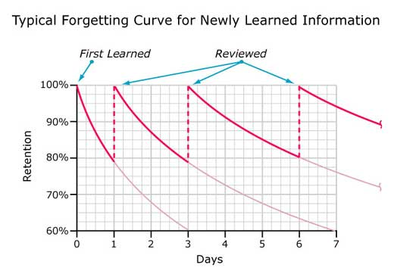
Revision Planning
Memory
Psychological research suggests that:
When we learn something, we rapidly forget much of it.
When we re-visit something we’ve learned repeatedly, we remember it better.
An Example of Ebbinghaus’ Forgetting Curve
Effective revision of the knowledge and skills covered in lessons is, therefore, crucial to exam success.
Notes:
SMS to present

Slide 8
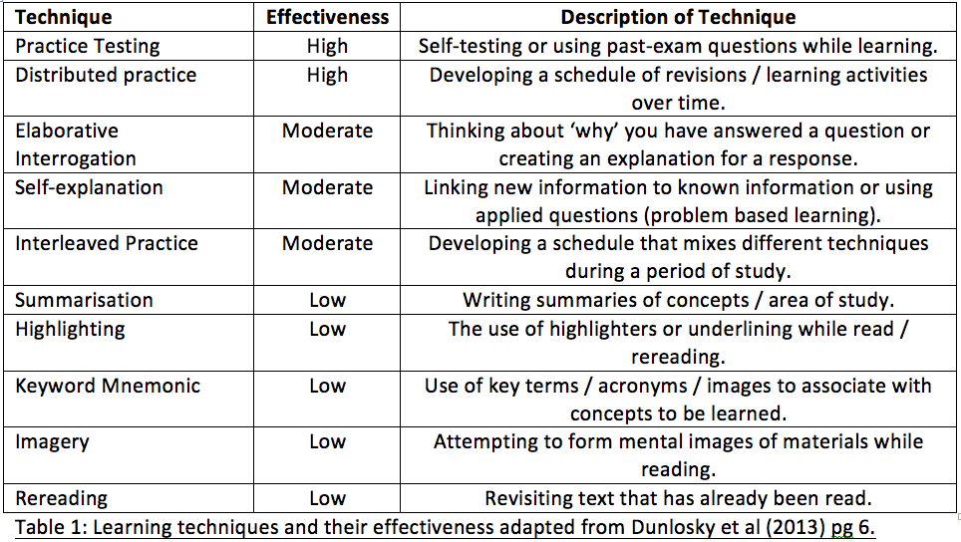
Revision Planning
Which revision strategies work best?
Learning Techniques and their Effectiveness: Dunlosky (2013)
Research has identified that some revision strategies are more effective than others. We need to ensure students are using the most effective methods when they sit down to revise.
Notes:
SMS to present

Slide 9
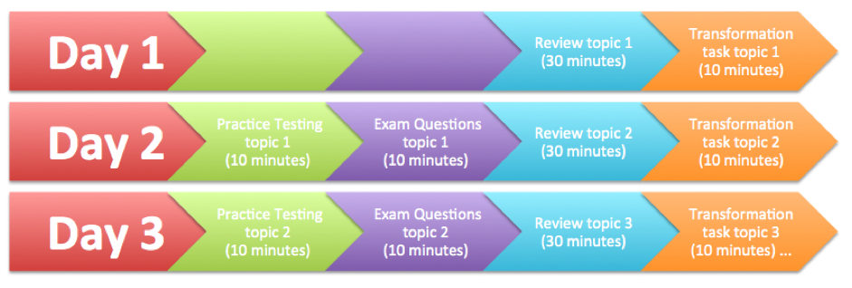
Distributed Practice [Practice over Time]
Vs.
Mass Practice [Cramming]
Cramming the week or night before an exam is not effective
Regular revision sessions, spaced out over a long period of time, are the most successful.
The more detailed or complex the information you are trying to remember, the longer the period of time needed.
It does not matter which of the revision techniques are used - distributed practice works well for them all.
Notes:
SMS to present

Slide 10
Interleaved Practice [Revising several topics in chunks]
Vs.
Block Practice[Revising one topic at a time]
Rather than revising in ‘topic blocks’ it’s better to chunk these topics up in your revision programme and interleave them.
Block Practice
Interleaved
Practice
Notes:
SMS to present

Slide 11
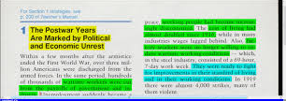
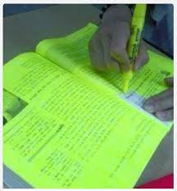
Revision Techniques
There are a range of techniques students can use when revising – some are effective and others less so.
Techniques to avoid:
Highlighting text
Re-reading notes
Summarising
These are not effective because:
Challenge is low
Little thinking is required
Gives a false sense of achievement
Notes:
SMS to present

Slide 12
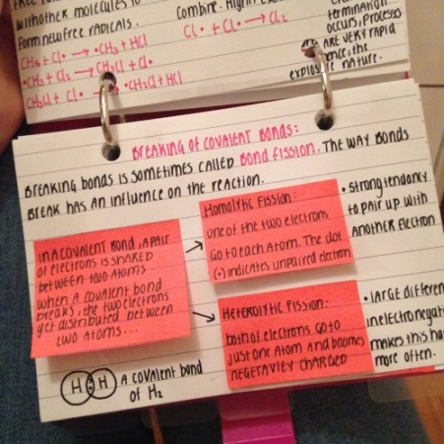
Revision Techniques
The most effective techniques students can use to aid their revision are:
Flashcards
Mnemonics
Interrogation [asking why?]
Mind Maps
PQRST [Preview, Question, Read, Say, Test]
Past Papers
Study buddying
Notes:
SMS to present but MHJ to talk about ‘Study Buddying’

