Slide 1
Highclare Preparatory Schools
Cygnets and Swans
Phonics Information Evening

Slide 2
“Once you learn to read you will be forever free.”
Frederick Douglass

Slide 3
It is crucial for children to develop a life-long love of reading. Reading consist of two dimensions: language comprehension and word reading. Language comprehension (necessary for both reading and writing) starts from birth. It only develops when adults talk with children about the world around them and the books that they read together. Enjoying rhymes, poems, songs, stories and non-fiction books together.

Slide 4
Skilled word reading, taught later, involves both the speedy working out of the pronunciation of unfamiliar words (decoding) and the speedy recognition of familiar printed words.
Writing involves transcription (spelling and handwriting) and composition (articulating ideas and structuring them in speech, before writing.
Development Matters 2020

Slide 5
Aim: To help you understand how we support children in their phonic journey.

Slide 6
Children in early years will be learning to understand:
That print has meaning
Print can have different purposes
We read English text from left to right and from top to bottom
The names of the different parts of a book
Page sequencing

Slide 7
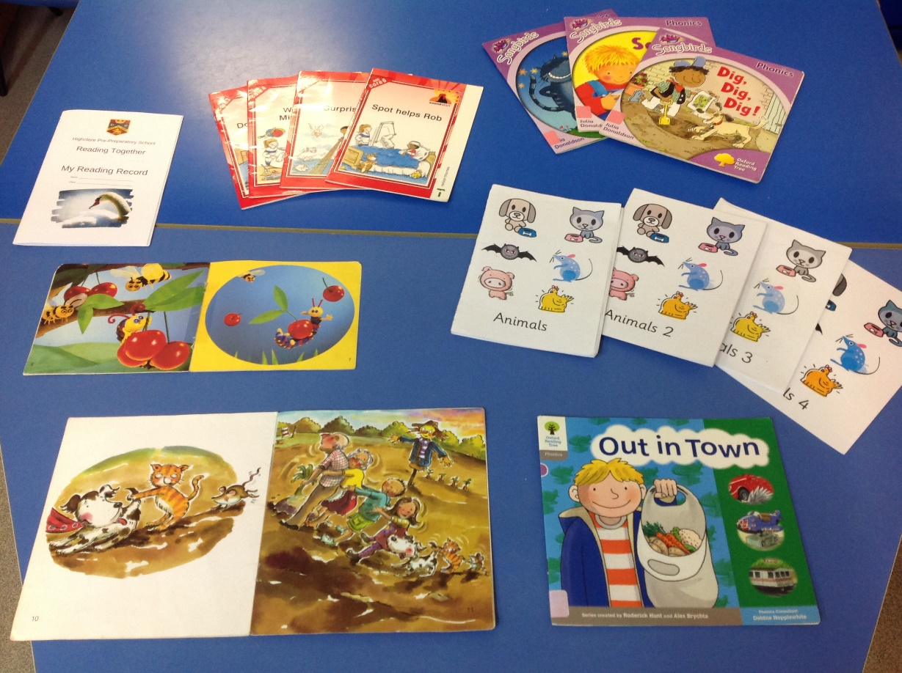
They will also:
Engage in extended conversations about stories learning new vocabulary. “Reading without reflecting is like eating without digesting.” Edmund Burke

Slide 8
Develop their phonological awareness so they can spot and suggest rhymes, count or clap syllables in a word, recognise words with the same initial sound
Use some of their letter knowledge in their early writing (eg. a pretend shopping list) – write some letters accurately
Write some or all of their name

Slide 9
Phase One
Joining children in their play to extend their talk and enrich their vocabulary.
Encouraging children to use language for thinking by asking open questions.
Providing activities where children can explore sounds.
Opportunities for role play where children can use language for a range of purposes.
Encouraging large movements to develop physical skills necessary for writing.

Slide 10
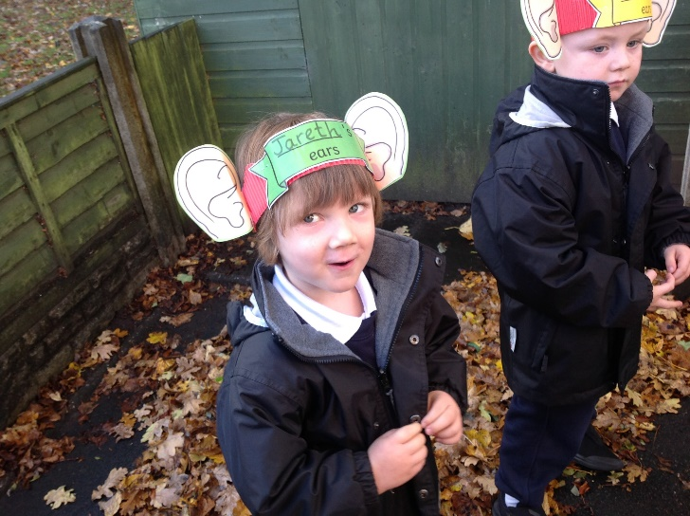
Sound discrimination
Environmental sounds – going for a sound walk; creating sounds by tapping, scraping etc. making shakers; animal sounds; encouraging children to ‘tune in’ and become good listeners.

Slide 11
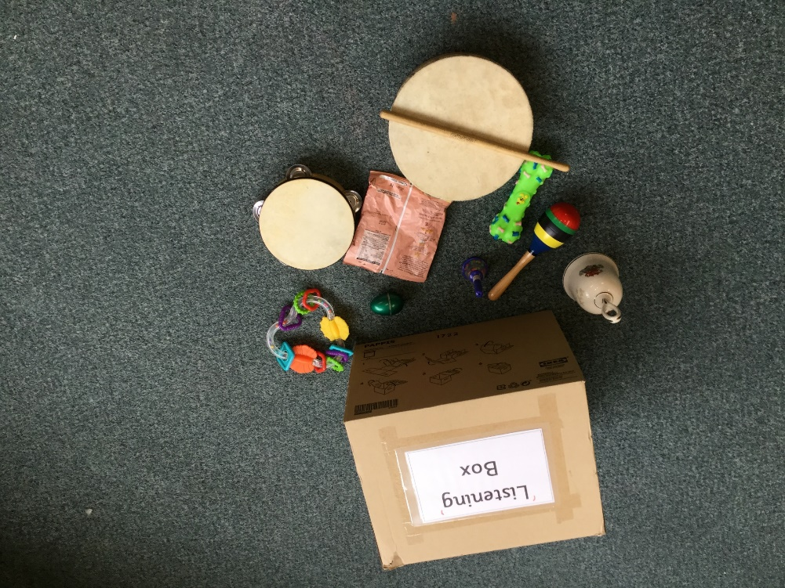
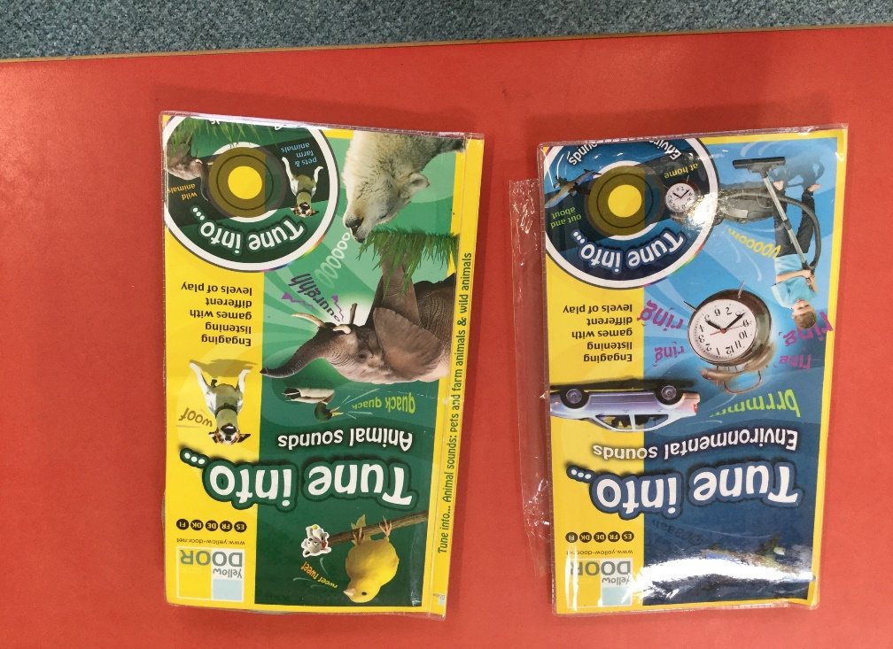

Slide 12
Instrumental Sounds
Playing with musical instruments indoors and outdoors.
Copying, making up simple rhythms (tapping out their name).
Matching sounds (hiding the instrument).
Story sounds (fairy fluttering, giant stomping…)

Slide 13
Body Percussion
Explore different ways of making sounds with our bodies (indoors and outdoors).
Follow the sound (patterns eg., clap, clap, clap) around the circle.
Action songs.
Follow the leader (moving fast, slow, quietly etc…)

Slide 14
Rhythm and Rhyme
Children need to build up a stock of rhymes by hearing them over and over again.
For children learning English as an additional language songs and rhymes help them to tune into the sound of English.
Word play : missing word; change the words.
Notes:
Homework should only take the prescribed amount of time (if it’s not finished parents can make a note in the homework diary)
Discuss Talk Homework, spellings and times tables/Keeping Skills Sharp (J5) etc.
Extra homework will always be provided at a parent’s request

Slide 15
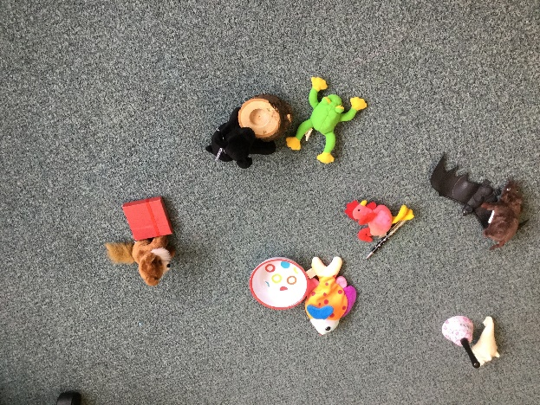
Rhyming games
Silly soup
Rhyming bingo
Rhyming pairs
Finish the rhyme
Odd one out

Slide 16
Alliteration
Our name rhymes
Tongue twisters
Collections of objects beginning with the same sound
Using pure sound (not adding ‘suh’ needs to be ‘ssss’ ‘mmm’ not ‘muh’
Notes:
Explain how children can use Highclare Virtual – lessons
Explain how parents can use Highclare Virtual to see the children’s homework and letters sent home (they use their parent log on)

Slide 17
Pure sounds
www.YouTube.com/watch?v=1wJx1NSineE

Slide 18
Voice sounds
Through stories, role play, sensory activities: ‘swish, swash, squelch, splosh…’
Water play: drip, splash, bubble, swoosh.
Climbing, moving noises: ‘weeee’
Loud, quiet, like a bee, like a clock, excited, disappointed etc…

Slide 19
Oral blending
Model oral blending: ‘Get your c-oa-t; ‘touch your f-ee-t’ …
I spy with my little eye a c-u-p, z-i-p,
h-a-t…
Cross the river (children hold an object, eg. peg). Call out p-e-g and child holding that object crosses the river.
Notes:
NB we have a number of children in school with severe nut allergies

Slide 20
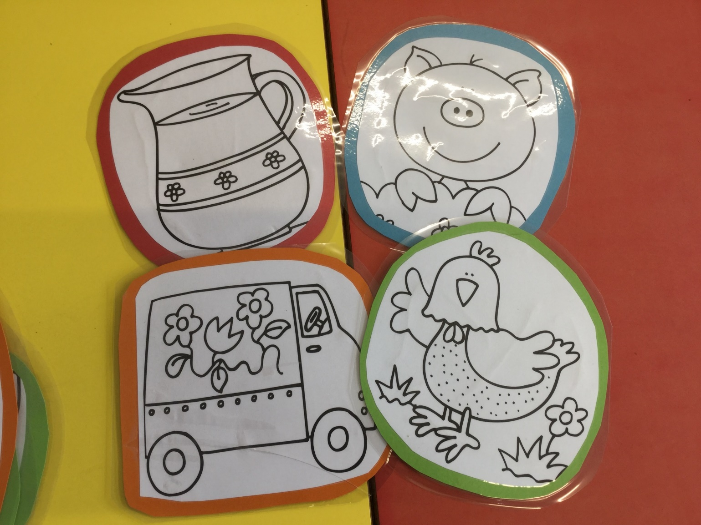

Slide 21
Phase Two
Children entering phase two will have experienced a wealth of listening activities including songs, stories and rhymes. They will be able to distinguish between speech sounds and many will be able to blend and segment words orally. Some will be able to continue a string of rhyming words.

Slide 22
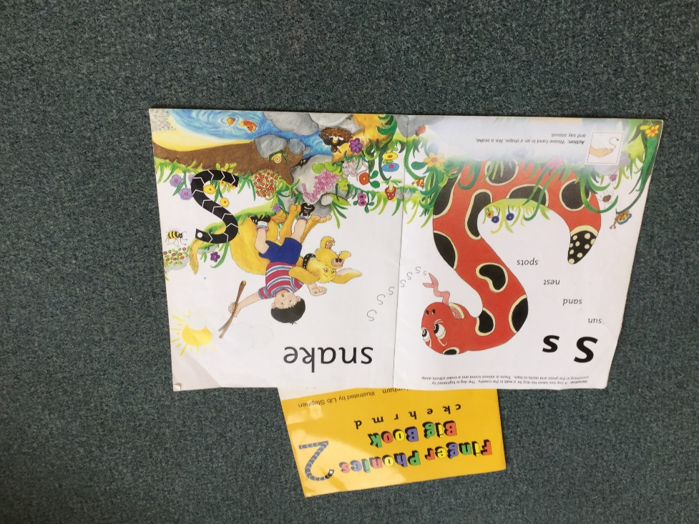
Letter Progression
Phonics is the step up to word recognition. Automatic reading of all words – decodable and tricky – is the ultimate goal.
We follow the order in Letters and Sounds.
We use the ‘Jolly Phonics’ big books to introduce each sound.
Notes:
Please remind parents to book their children into TOPs (due to staff ratios)

Slide 23
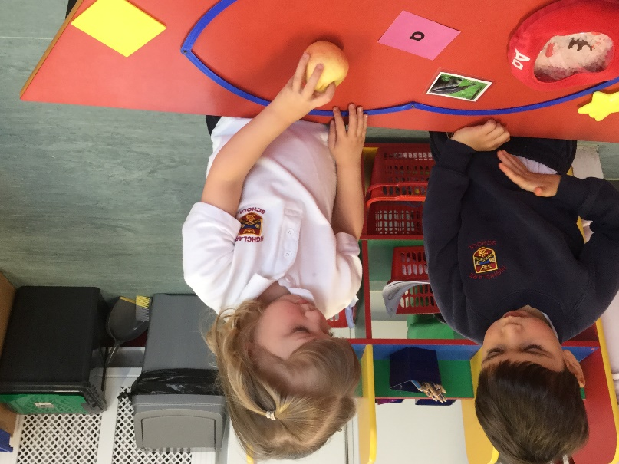
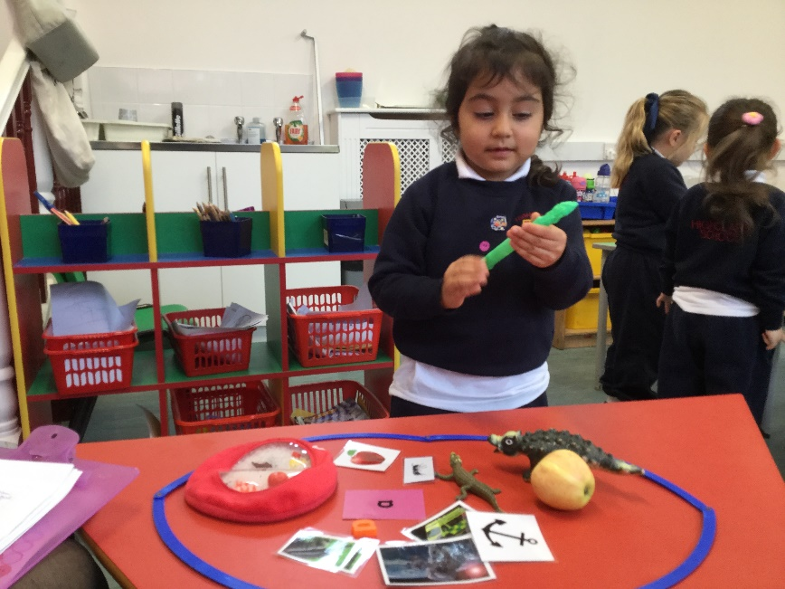
Initial Sounds – When children have learned more than one sound they can begin sorting by initial sound

Slide 24
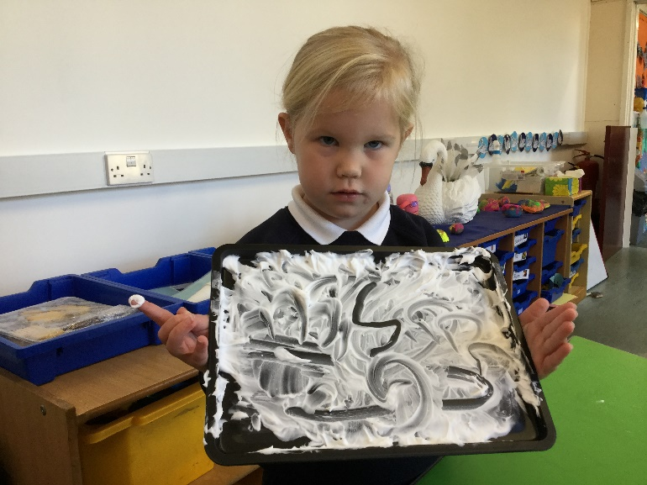
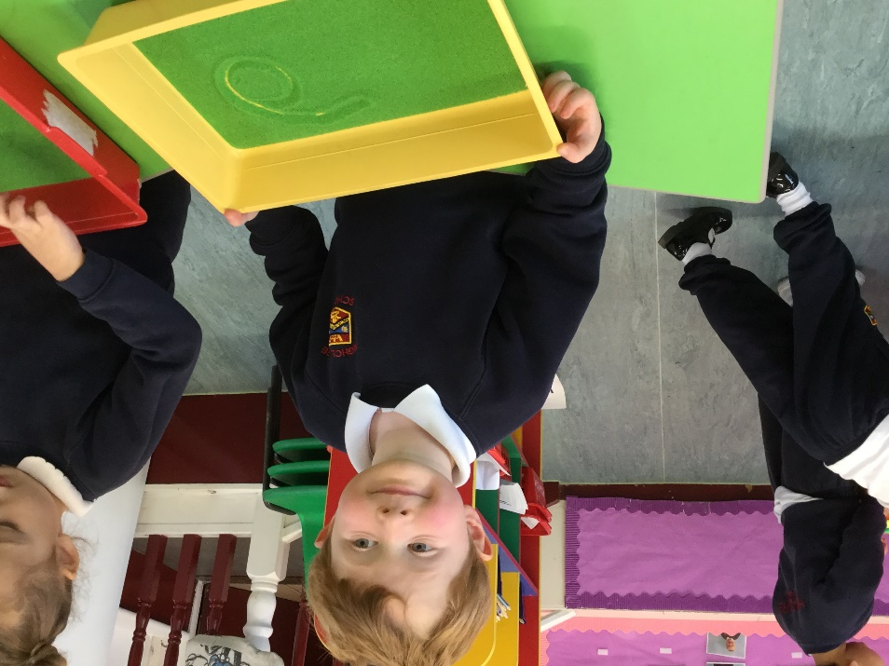
Learning to write letters in different and interesting ways.

Slide 25
Blending c-v-c words

Slide 27
High Frequency Words Tricky Words
Many words cannot be blended to read but simply have to be learnt to sight read. They are words that occur frequently in text so can play games such as ‘spot the word’ or use highlighters to find the tricky word.

Slide 28
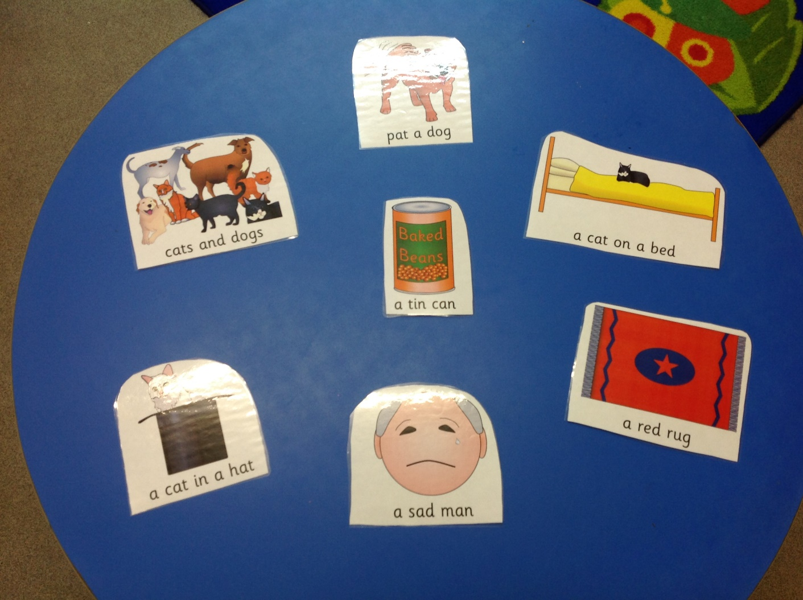
Reading Captions

Slide 29
The more you read
The more things that you know
The more you learn
The more places you will go
Dr Seuss

