Slide 1
Study Sensei
Follow-up Tutor Pack
Elevate UK
Highclare School

Slide 2
How to Use
Resource Outline
This follow up series is built around the Elevate Study Sensei workshop and is designed to reinforce the note-taking practices covered in the session.
How to Use
These resources are designed to fit around your form time schedule. As such, you have a 5-, 10- or 20-minute option with each skill:
5 minutes highlights the application of a skill through a follow-up video;
10 minutes allows for a class discussion around the contents of the video and the skill itself;
20 minutes gives students the opportunity to put into practice what they’ve watched and discussed through an activity.
These slides are editable, so please change activity and discussion content where applicable to your students needs!
Further resources
We want students to re-visit these resources as much as possible. As such, you can find a link to all the templates and videos on the next slide. Please share these with your students after they have first gone through the pack with you in class.
We can then track the engagement of your students with the resources for additional oversight. To access this data, please speak with whoever is in charge of organising the Elevate Programme at your school.

Slide 3
Contents
1. Planning and Organising Your Notes
Video: How to use a planner and a folder
Discussion: How do you currently organise your notes? What do you need to make sure you use the planner effectively​
Activity: How would you help this student fix their note making planner?​
2. Note Making
Video: How to make effective notes
Discussion: What are the most important things to remember when making notes?​
Activity: Write a set of notes based on this text​
3. Reviewing Your Notes
Video: How to use a System of Review
Discussion: When is the best time for you to re-read notes? What is the best technique for you?​
Activity: Create a set plan you can stick to for your system of review
4. Going Beyond the Notes
Video: How to read around a subject and where to source that info
Discussion: Have you ever done this before? If so, which subject, and where did you look? If not, why?
Activity: Pick 1 topic from any subject right now, and research one extra fact about it

Slide 4
Planning & Organising Your Notes
Video – 5 mins
Click the image below for your video:
Download the Note Making Planner template here!

Slide 5
Planning & Organising Your Notes
Discussion – 5 mins
How do you currently organise your notes?
&
What do you need to make sure you use the planner effectively​?
Spend 5 minutes discussing the following:

Slide 6
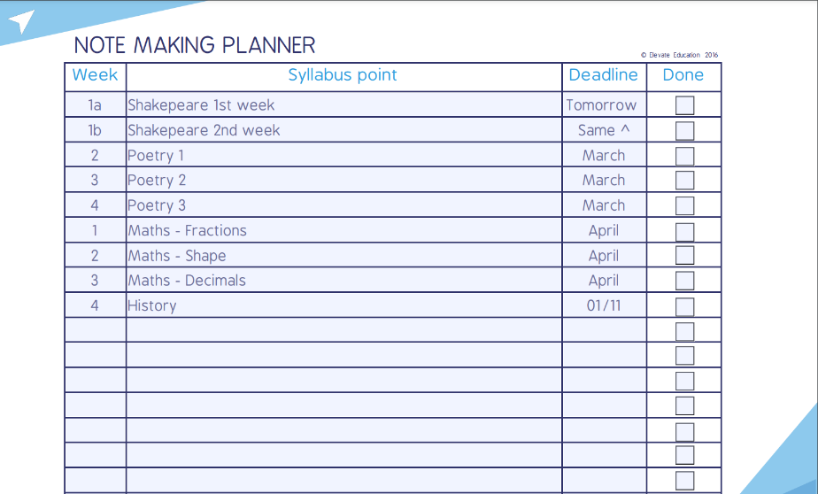
Planning & Organising Your Notes
Activity – 10 mins
How would you help this student fix their note making planner?
Write down 3 things you would change, and then share your answers with the person next to you.

Slide 7
Note Making
Video – 5 mins
Click the image below for your video:

Slide 8
Note Making
Discussion – 5 mins
What are the most important things to remember when making notes?​
&
What’s the biggest change you need to make to your notes?
Spend 5 minutes discussing the following:

Slide 9
Note Making
Activity – 10 mins
Based on what you now know about note-taking, create a page of notes.
If you have a revision guide with you, use this to find a topic you’re currently studying.
If you don’t have a revision guide with you, use the text on the right.

Slide 10
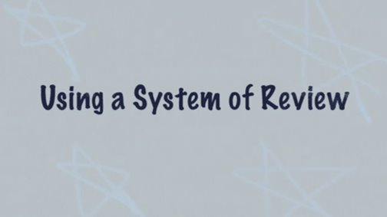
Reviewing Your Notes
Video – 5 mins
Click the image below for your video:

Slide 11
Reviewing Your Notes
Discussion – 5 mins
When is the best time for you to re-read notes?
&
What is the best technique for you?​
Spend 5 minutes discussing the following:

Slide 12
Reviewing Your Notes
Activity – 10 mins
Create a set plan you can stick to for your system of review
Think about…
When you could review;
What notes you could be reviewing from today;
Where you could review (bedroom/bathroom etc).
When | What | Where

Slide 13
Going Beyond the Notes
Video – 5 mins
Click the image below for your video:

Slide 14
Going Beyond the Notes
Discussion – 5 mins
Have you ever done this before? If so, which subject, and where did you look?
&
If you haven’t, why do you think this is?
Spend 5 minutes discussing the following:

Slide 15
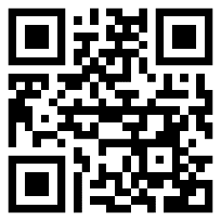
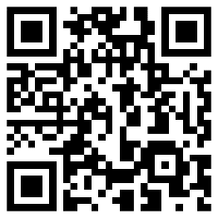
Going Beyond the Notes
Activity – 10 mins
Pick 1 topic from any subject right now, and research one extra fact about it
Google Scholar
Jstor Open & Free
If you don’t know where to start, try using these websites!

Slide 16
Feedback
For Teachers
We’d love your feedback on these follow-up resources.
We want to make them:
Easy to use for teachers;
Clear & helpful for students;
A part of your Elevate programme, so your school can embed the skills from our workshops.
And your feedback will help us get there. So click the link below and just take 30-60 seconds to fill out the questions so we can continue to improve. Thank you:
https://www.surveymonkey.co.uk/r/StudySenseiResources

